Slide 1
Southeast Area Study Update
June-July 2023
seareastudyupdate.com

Slide 2
Agenda
Project Background
Land Use Scenario Planning
Draft Modal Recommendations
Project Prioritization
Public Engagement

Slide 3
Project Background

Slide 4
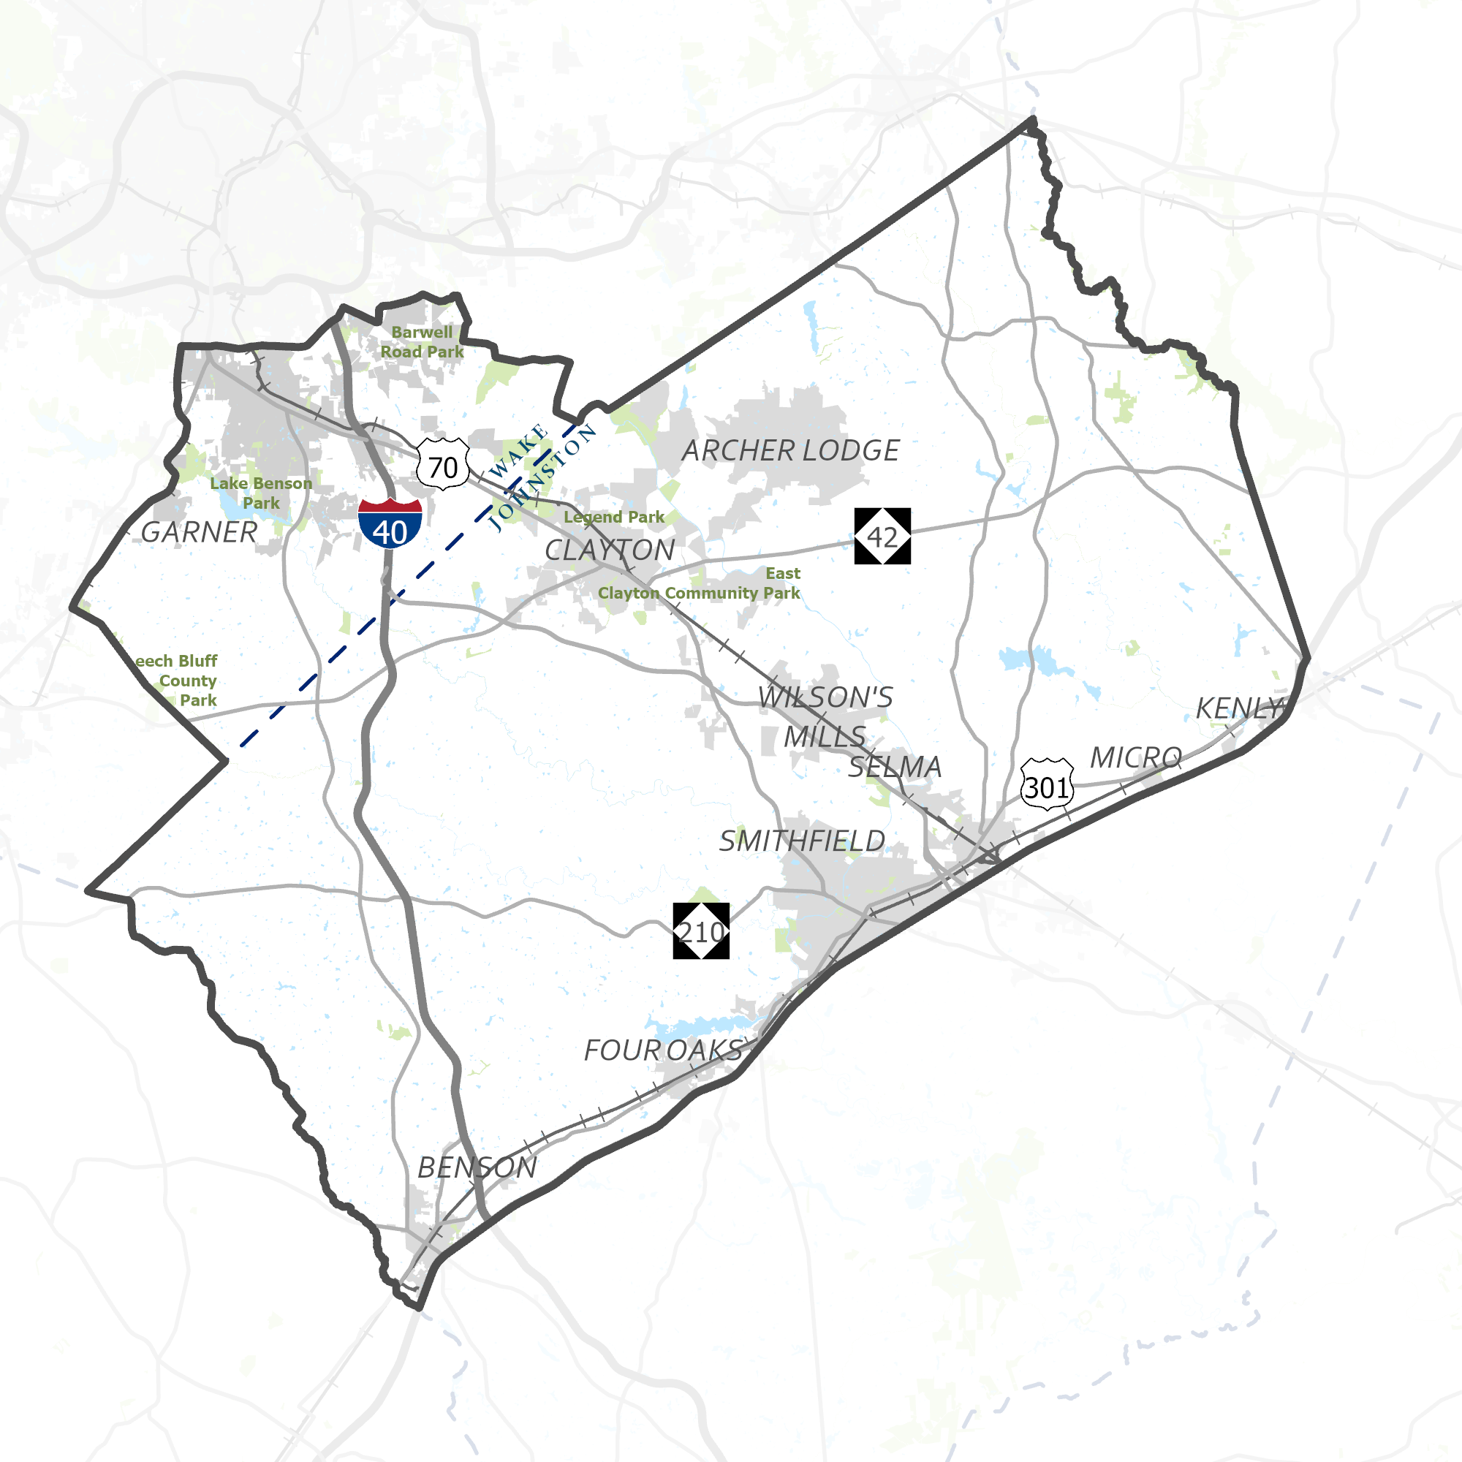
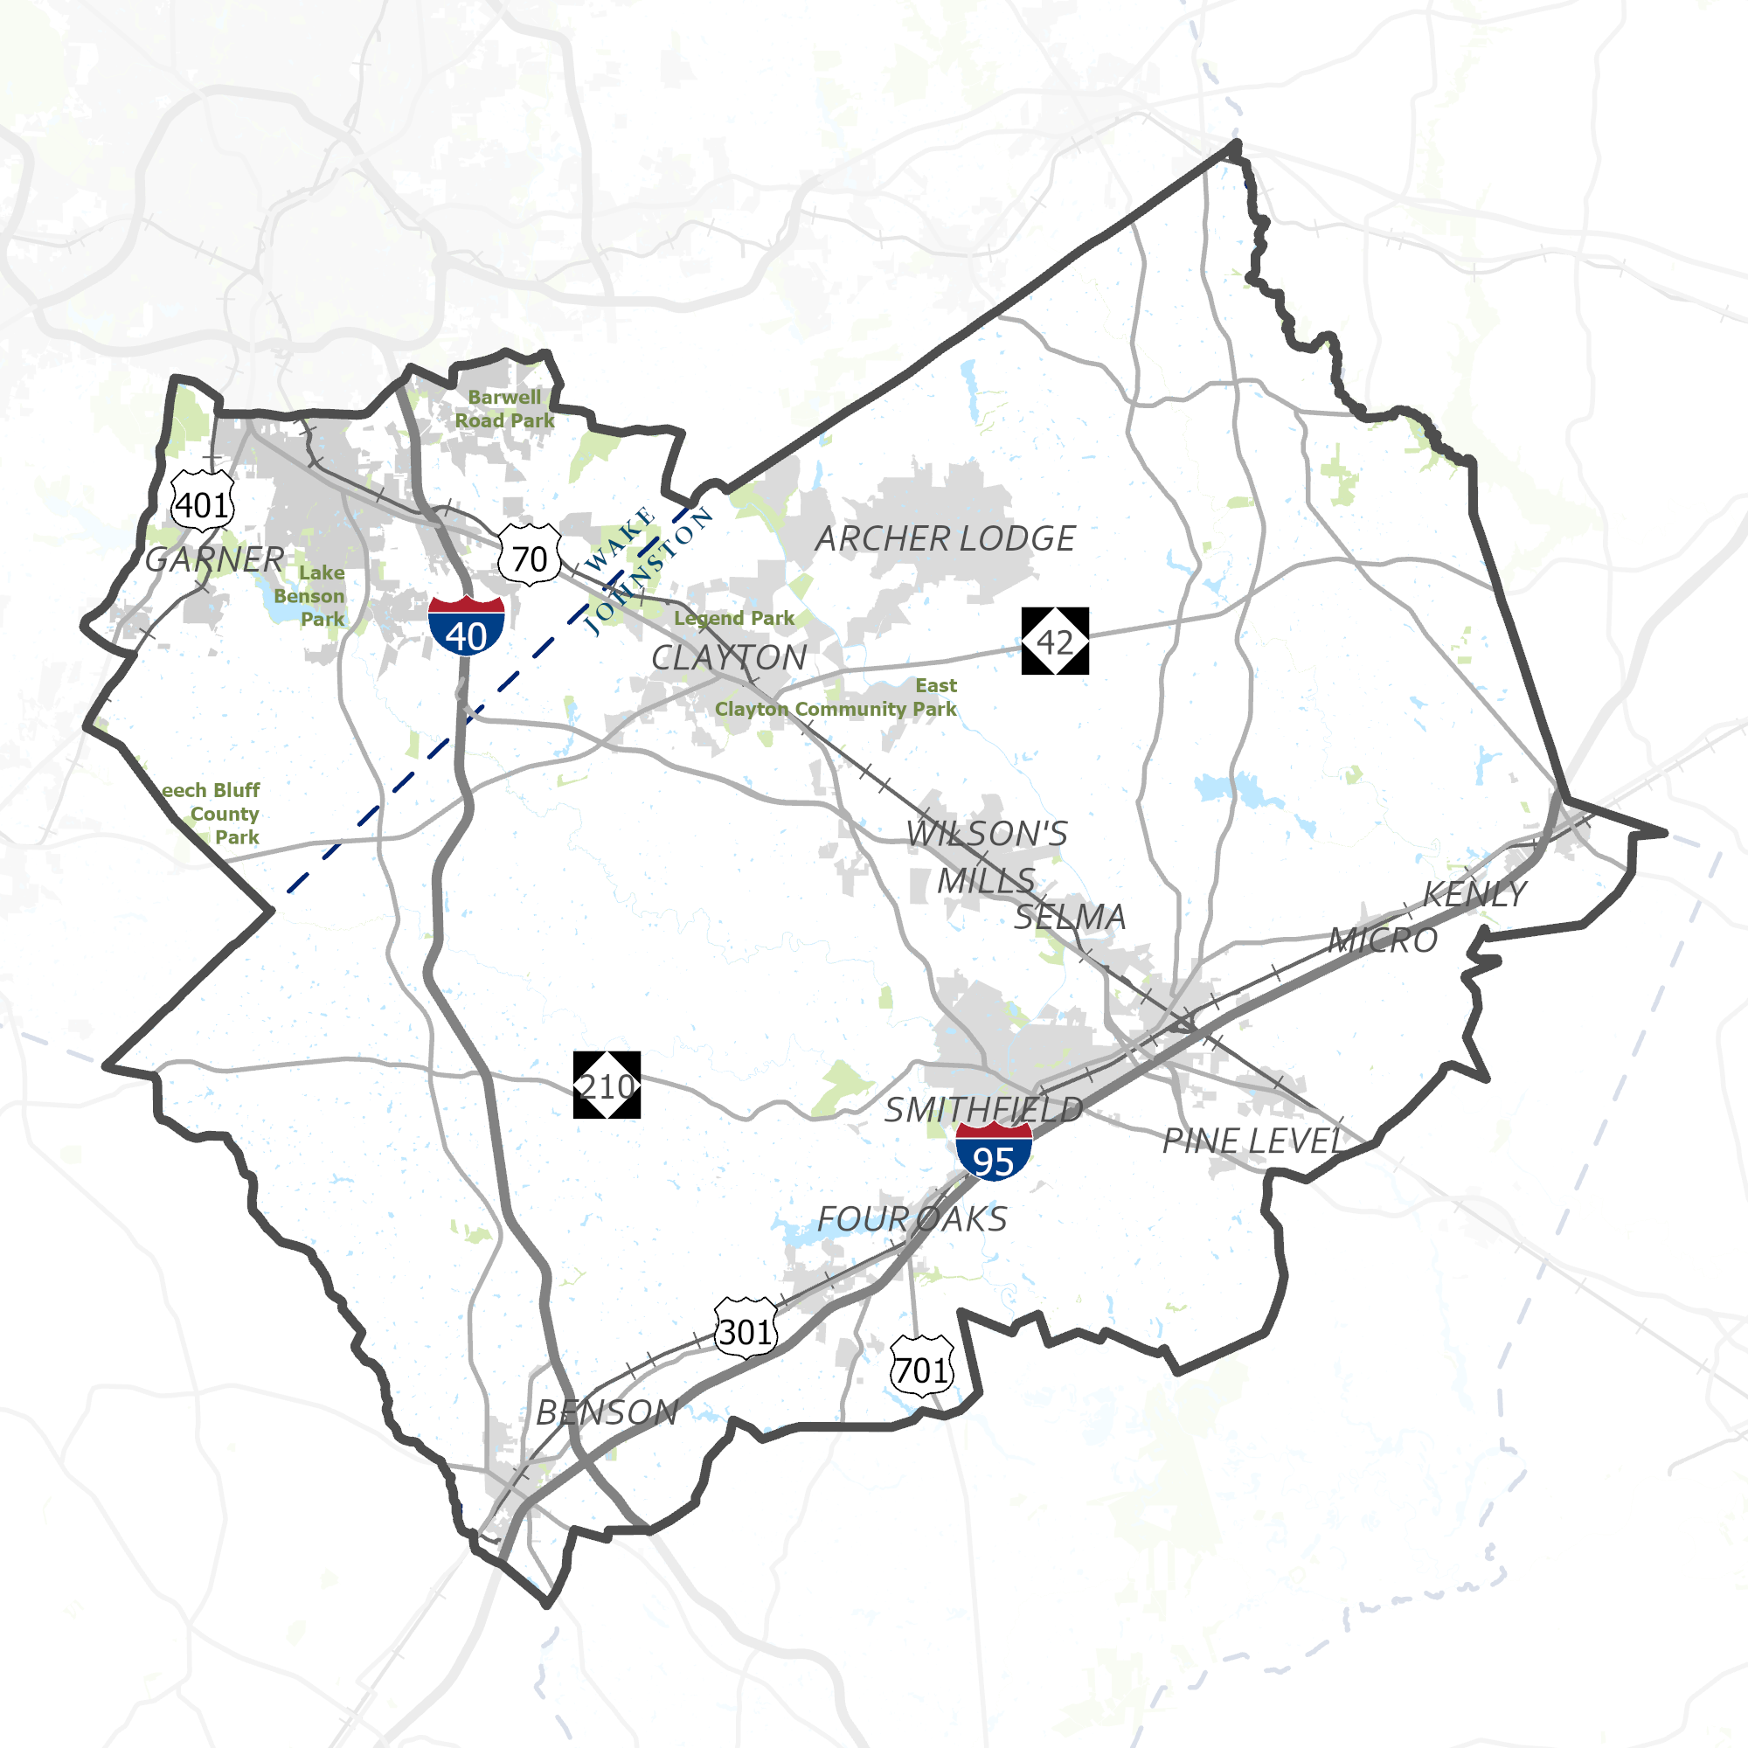
What is the SEAS Update?
2017 SEAS
This study integrates land use and transportation to accommodate existing and future travel needs for the purpose of reevaluating and revising, as needed, the unified vision and comprehensive transportation strategy established in the 2017 SEAS.
2023 SEAS
Notes:
This plan is an update to the existing Southeast Area Study, completed five years ago in 2017. The Southeast Area Study establishes a unified vision for the integration of land use and transportation to accommodate existing and future travel needs.
The study area includes:
Archer Lodge
Benson
Clayton
Four Oaks
Garner
Kenly
Micro
Pine Level
Selma
Smithfield
Wilson's Mills
Portions of Raleigh, Wake, and Johnston Counties

Slide 5
Guiding Principles
Notes:
During the first phase of engagement, we asked the public about their vision for the southeast area. From that feedback, the 2017 guiding principles were updated to be inclusive of feedback from the public, the SOT, and the CTT.

Slide 6
What are the Outcomes?
Notes:
The Southeast Area Study Update recommends regional improvements for future land use and development and multiple modes of transportation. The study includes recommended projects to improve roadways, bicycle and pedestrian facilities, and transit systems. The plan even takes a deeper dive into intersections with dedicated hot spot studies that aim to solve problem areas. Finally, it has policy recommendations to complement and support the proposed projects. The recommendations that come out of the Southeast Area Study Update will inform the Metropolitan Transportation Plan (or MTP), a region-wide long-range transportation plan that is updated every four years.

Slide 7
Project Schedule
March – April ‘22
May – Dec ‘22
Jan – June ‘23
July – Sept ‘23
Oct - Nov ‘23
Project Kickoff
Baseline Conditions Analysis
Recommendations Development
Plan Development
Presentations and Adoption Efforts
Public Engagement
Discover
May – August 2022
Involve
September 2022 – July 2023
Consult
August – October 2023
Notes:
We kicked off this project in March of last year and have worked through background data gathering and existing conditions analysis to get to where we are now. Since January we’ve been developing our recommendations for the plan—which we’ll get into next—but looking ahead, in August we’ll be writing the draft plan and working towards the endorsement of the Southeast Area Study by the Capital Area Metropolitan Planning Organization’s Executive Board.

Slide 8
Land Use Scenario Planning
Preferred Scenario

Slide 9
Land Use Scenario Planning | Process
2055
Today
Existing Plans Scenario
Current Trend
Alternative Path
Scenario A
Corridors
Alternative Path
Scenario B
Centers
Scenarios are illustrative examples that provide insight into different futures and associated outcomes
Notes:
Since this update is planning towards the year 2055, we first try to understand where we’ll be in 30 years. Scenario Planning is the process for testing illustrative examples of different potential futures. Scenarios are created by changing the future land use, or where we want to direct the growth of homes and jobs. These Scenarios represent the alternative paths we could potentially take.

Slide 10
Land Use Scenario Planning | Process
Today
Existing Plans Scenario
Current Trend
2055
Alternative Path
Blended Preferred Scenario
Scenario A
Alternative Path
Scenario B
Notes:
Once the three scenarios are scored and measured against each other, we use the outcomes to create our preferred scenario, which is a more realistic blend of the three scenarios. Our preferred scenario encourages more compact growth near our existing downtowns and urban centers while preserving the rural character of our study in the surrounding landscape. Since transportation is tied to land use, the preferred scenario is used to determine the recommended transportation improvements.

Slide 11
Preferred Land Use Scenario | What We Heard
Preference of Centers Scenario
Increase Multifamily Housing
More Density was Preferred
Land Consumed (Preservation) & Housing Mix are Important Metrics
Notes:
The preferred scenario was built after feedback from the Core Technical Team (CTT) on the results of the interim scenarios (existing plans, centers, corridors). The CTT had a preference of the centers scenarios and wanted to increase density overall. This was achieved by adding more multifamily housing and preserving the rural character of Johnston County.

Slide 12
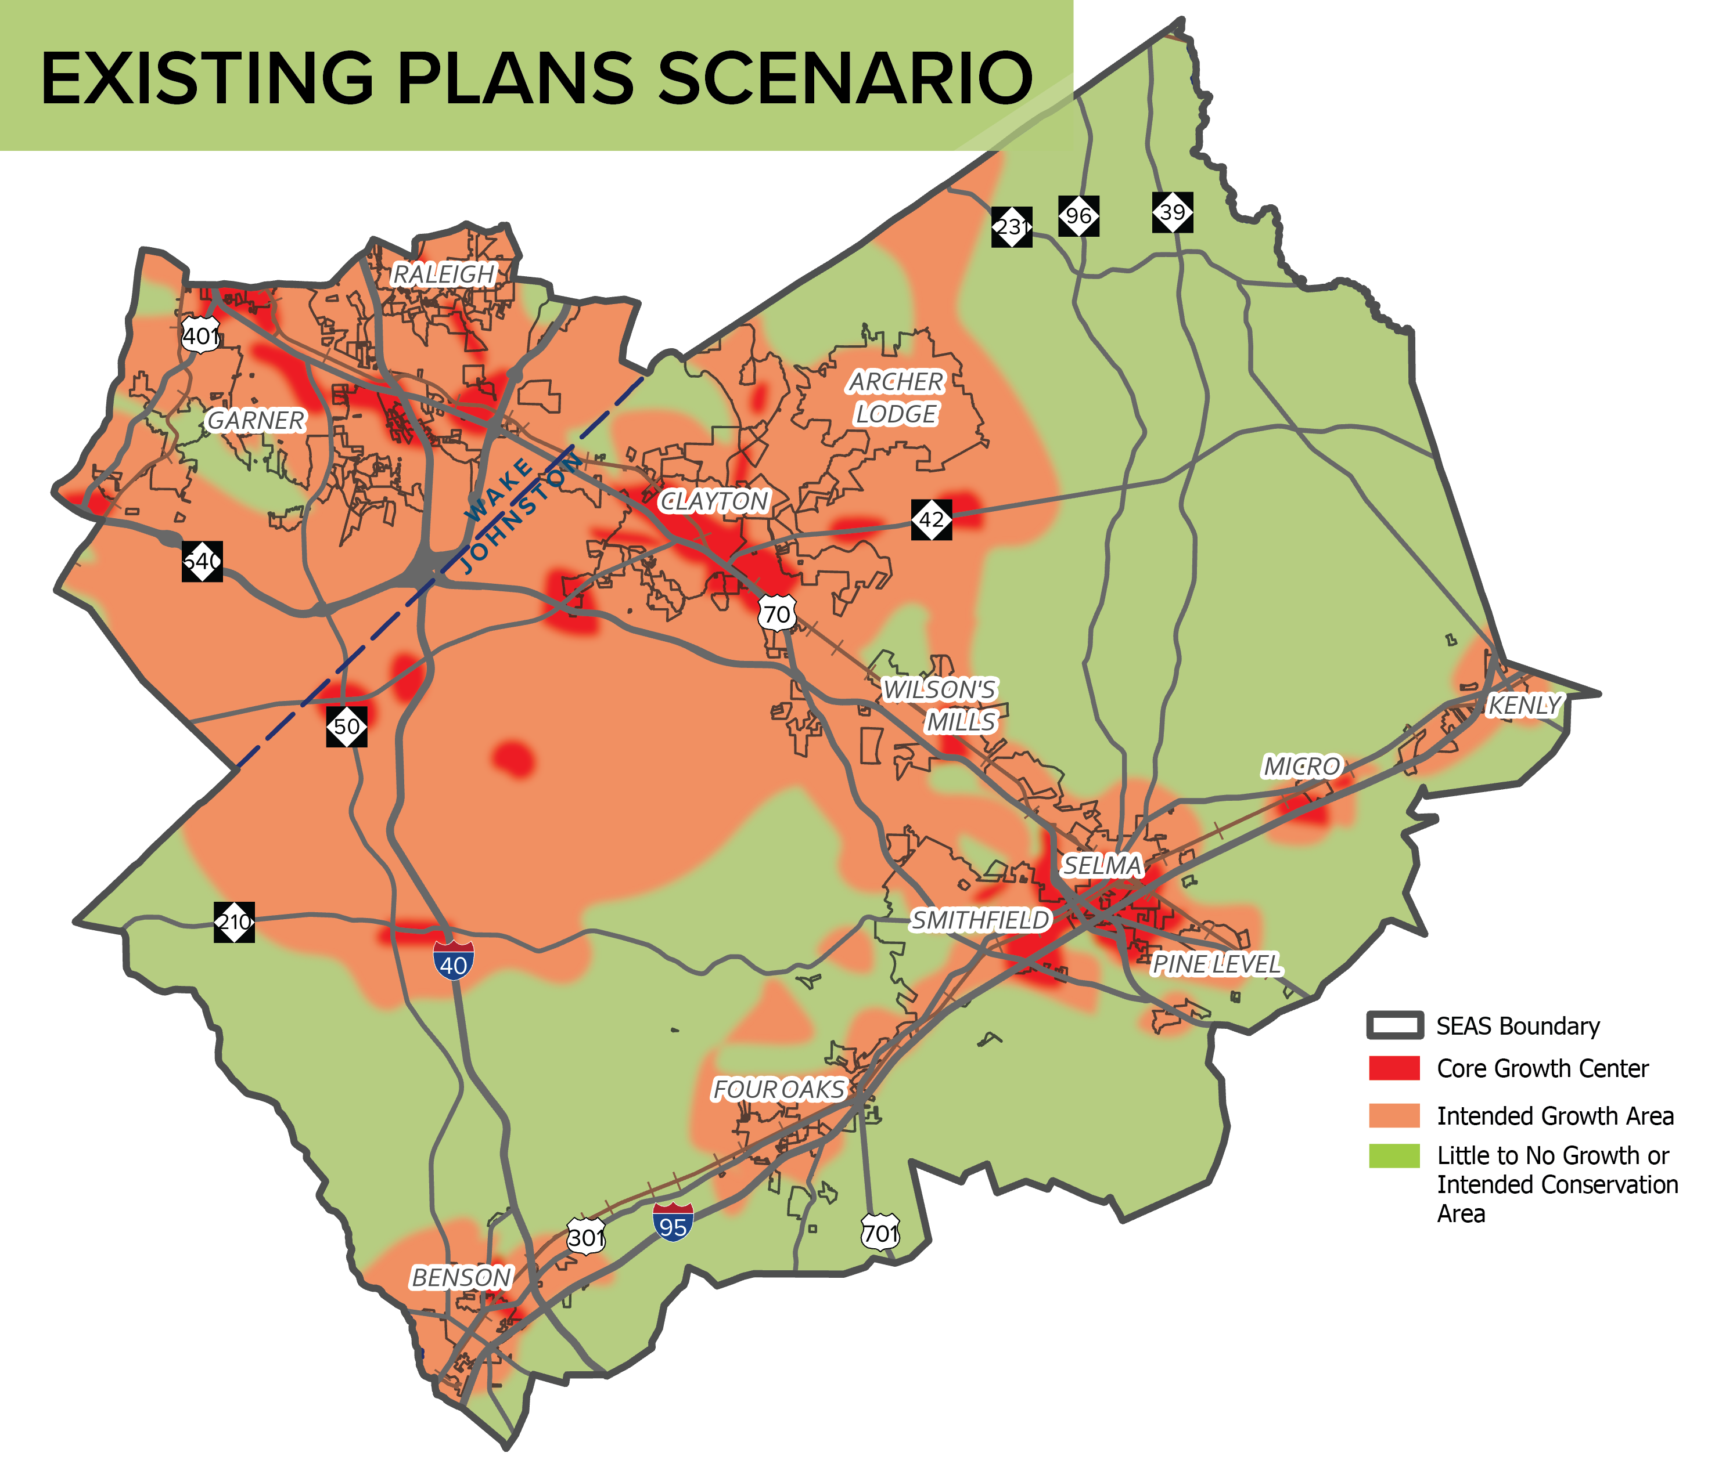
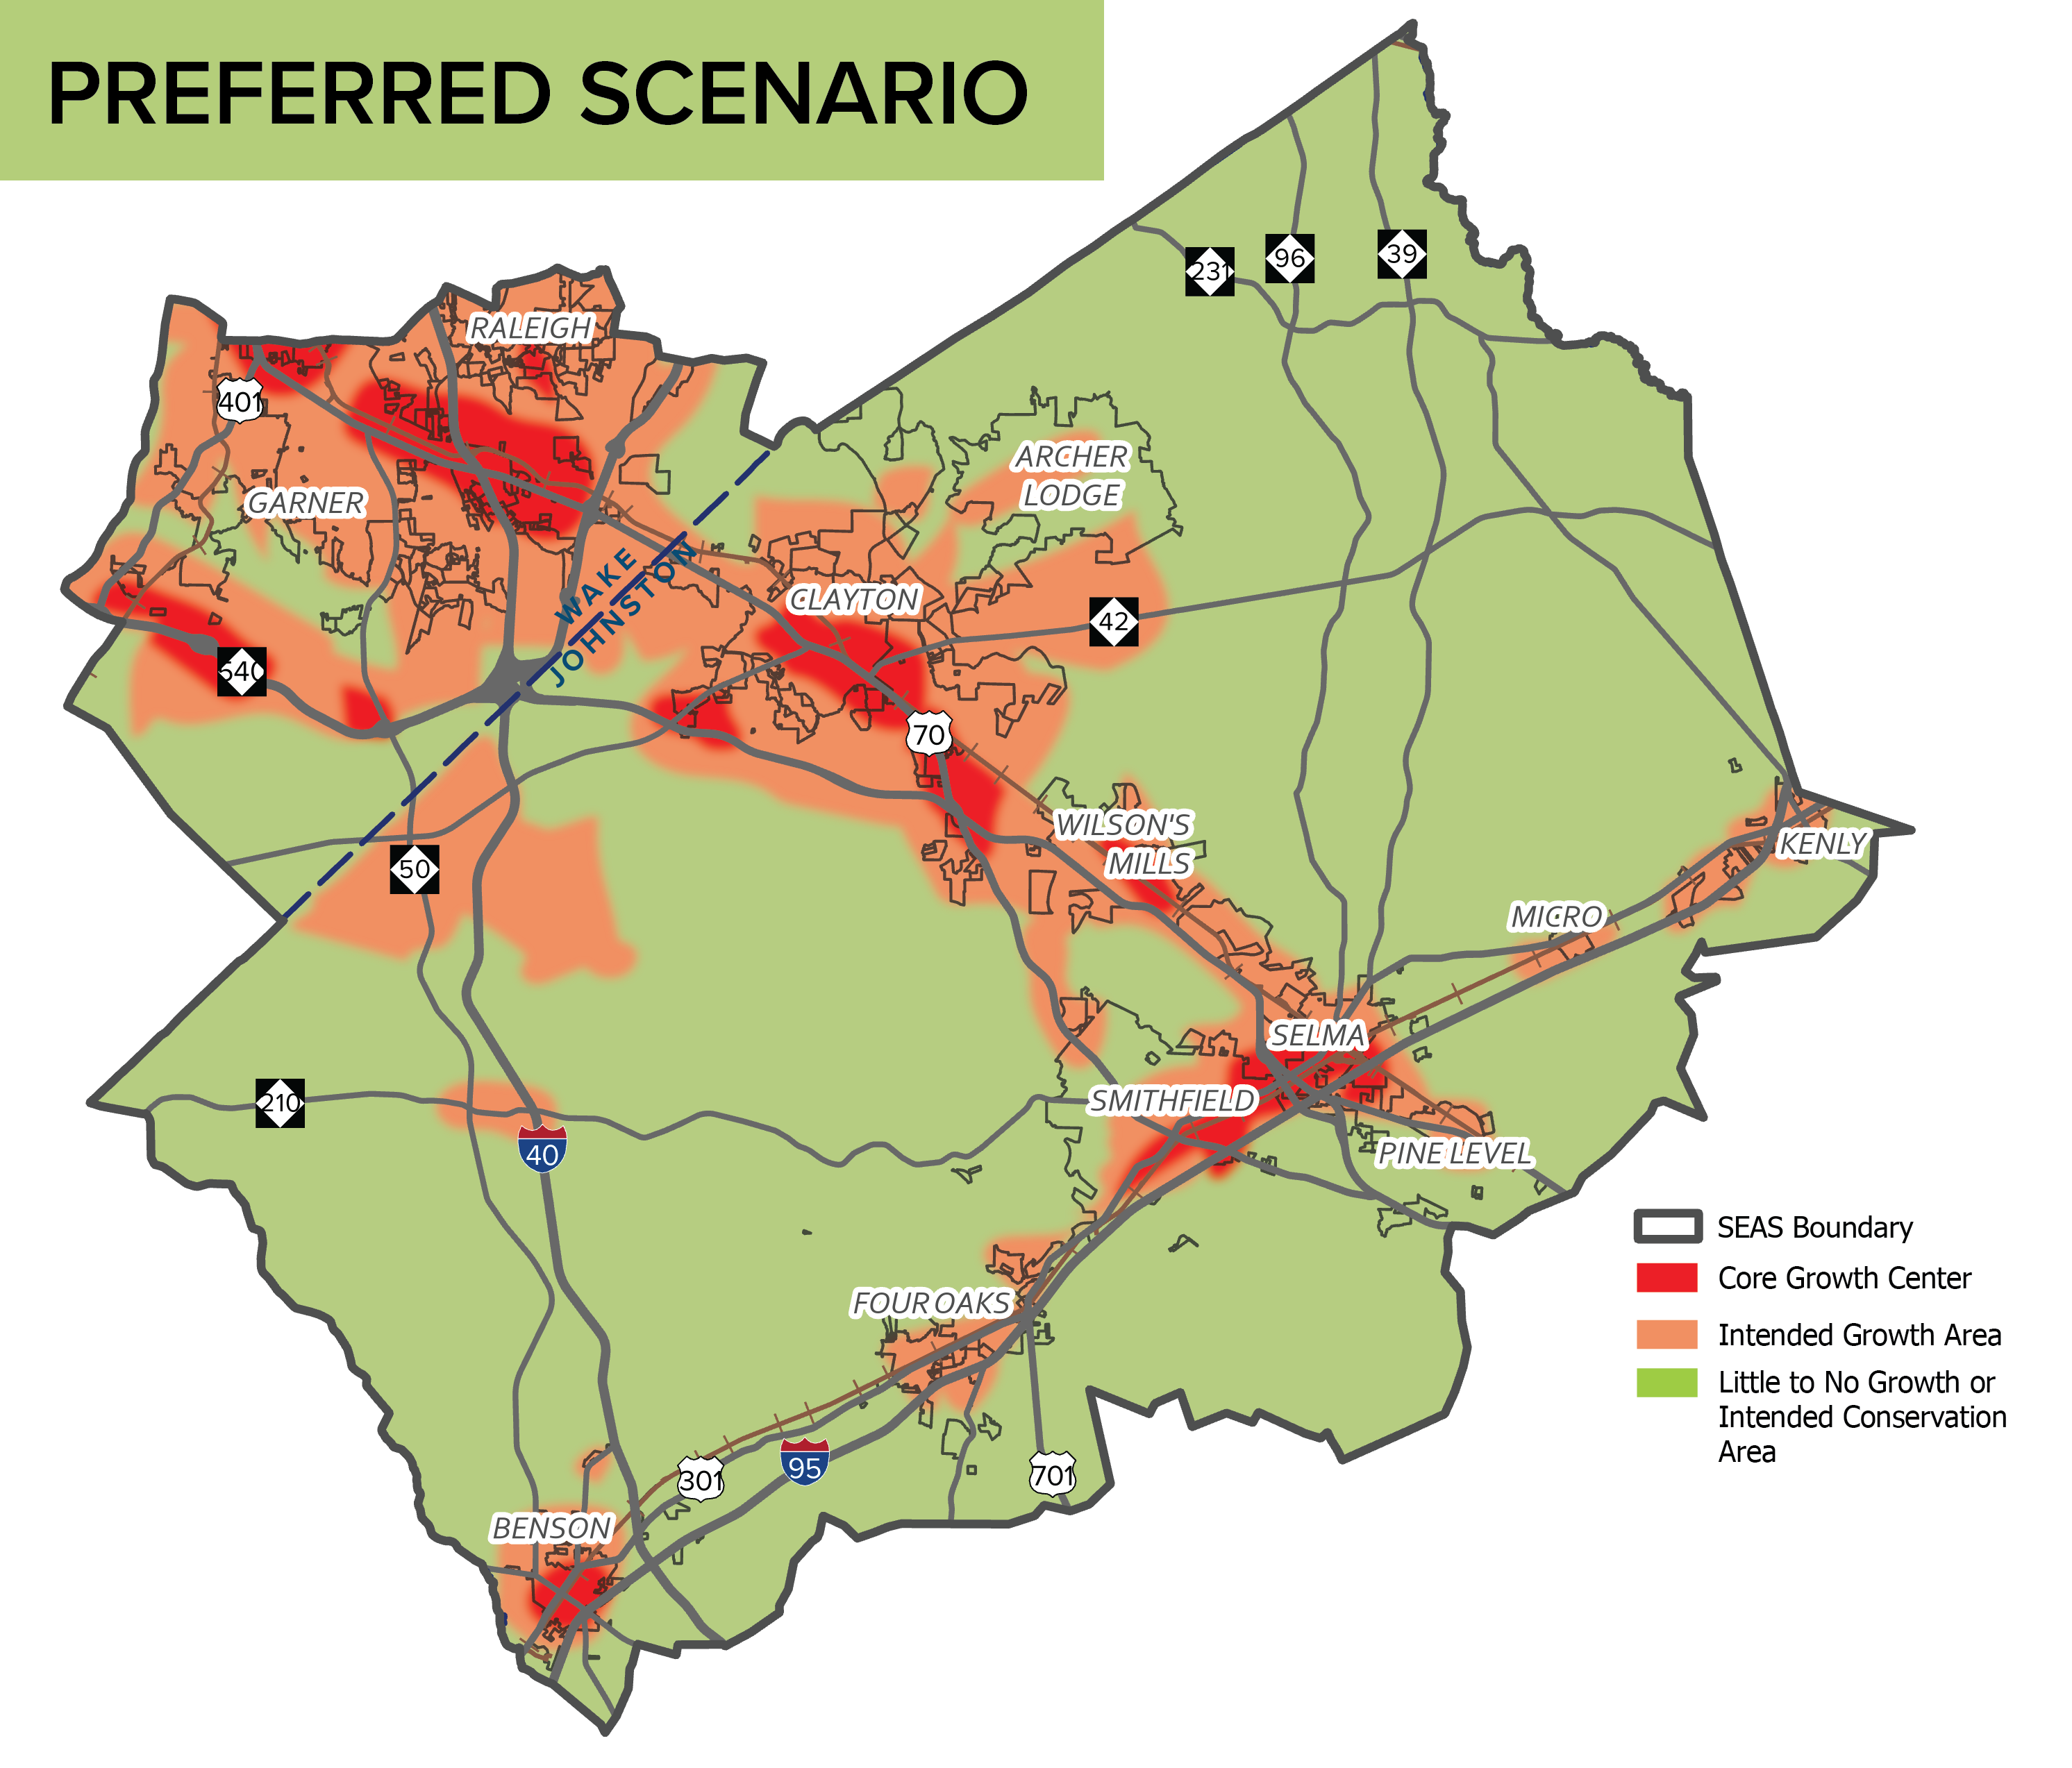
Land Use Scenarios | Compared
Existing Plans
Preferred
Notes:
The preferred land use scenario focuses growth in towns and along major corridors like US 70 and US 301, while discouraging sprawl in rural areas. This scenario is intended to encourage more compact development while preserving the rural character of Johnston County.

Slide 13
Excellent
Good
Scenario Scorecard
About the Same
Poor
Very Poor
Indicator | Existing Plans | Preferred | Guiding Principle
Urban Land Use Shift (sq mi) | 1.55 | p
Suburban Land Use Shift (sq mi) | 45.32 | q
Rural Land Use Shift (sq mi) | 11.85 | p
Net Residential Density | 3.70 | p
Mix of Housing Types | - | p
Developable Area of Walkable Place Types (sq mi) | 11.00 | p
Homes near Transit | 33,800 | q
Jobs near Transit | 90,680 | p
Job and Home Balance | 1.07 | p
Vehicle Miles Traveled | 14,954,900 | p
Vehicle Hours of Delay | 22,910 | p
Lane Miles of Congested Corridors | 190 | q
The Preferred Scenario is ultimately used as a decision-making tool in planning. The recommendations that come out of the SEAS Update support the preferred scenario.
Notes:
The preferred scenario performs better in the majority of our performance measures. The Preferred Scenario is ultimately used as a decision-making tool in planning. The recommendations that come out of the SEAS Update support the preferred scenario.

Slide 14
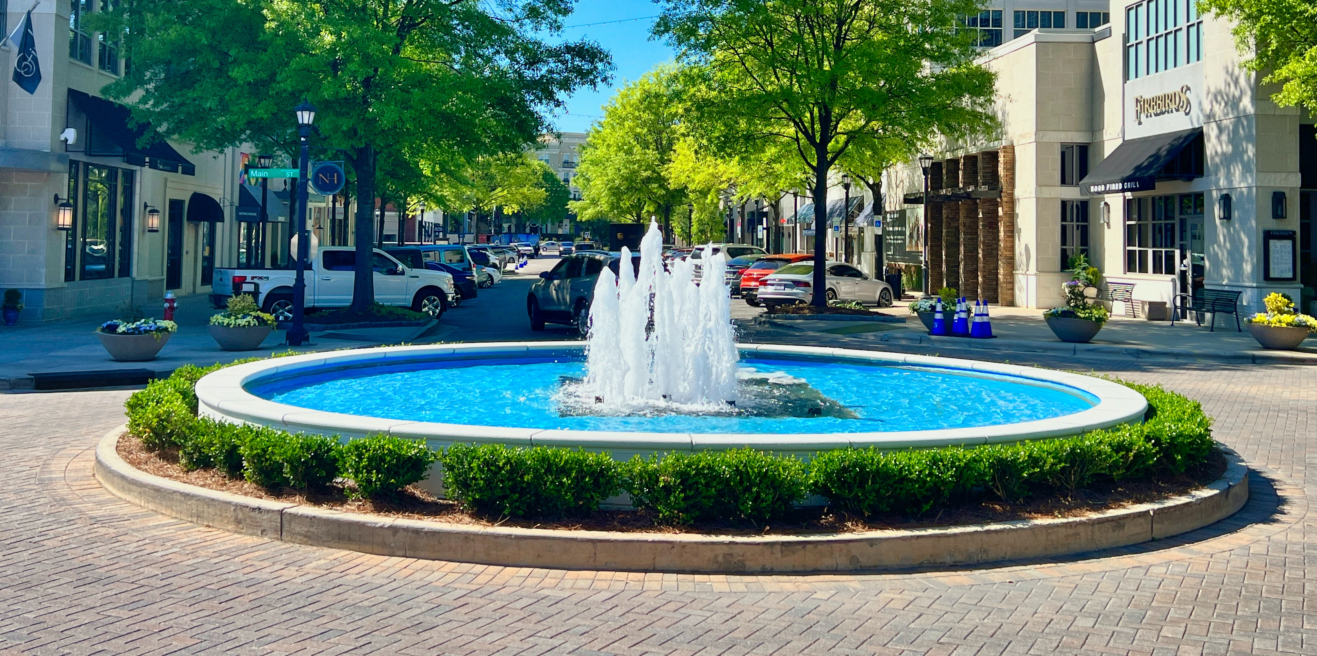
Land Use | Operationalizing Policies
Transportation and Connectivity
Street cross-sections that support land use and character goals
Connect street networks
Support bike/ped expansion
Right-size parking
Create design guidelines
Economic Development
Coordinate land use with economic development
Develop downtown redevelopment strategies
Facilitate building re-use
Flexibility to respond to market shifts and planning “unknowns”
Growth and Housing
Support higher densities in growth/redevelopment areas
Preserve lower densities in rural and agricultural areas
Support a range of housing options in growth areas
Encourage mixed use at key growth nodes
Notes:
The 2023 SEAS will focus on putting these policies to use in key focus areas, such as housing, bicycle and pedestrian improvements, mixed use development, and more. Examples include:

Slide 15
Draft Modal Recommendations
Bicycle and Pedestrian
Transit
Roadway
Hot Spot

Slide 16
Recommendations | Development Process
Notes:
The recommendations development process is two-fold, using both quantitative data and qualitative feedback received throughout the plan. First, we catalogue all the existing projects. Next, we identify remaining needs based on congestion and safety information, land use context, public input, and other data. From that we create a set of draft multimodal recommendations that we ask for input on from our technical committee, stakeholders, and the public. This is the stage we are currently in. From that feedback gathered we finalize our recommended projects.

Slide 17
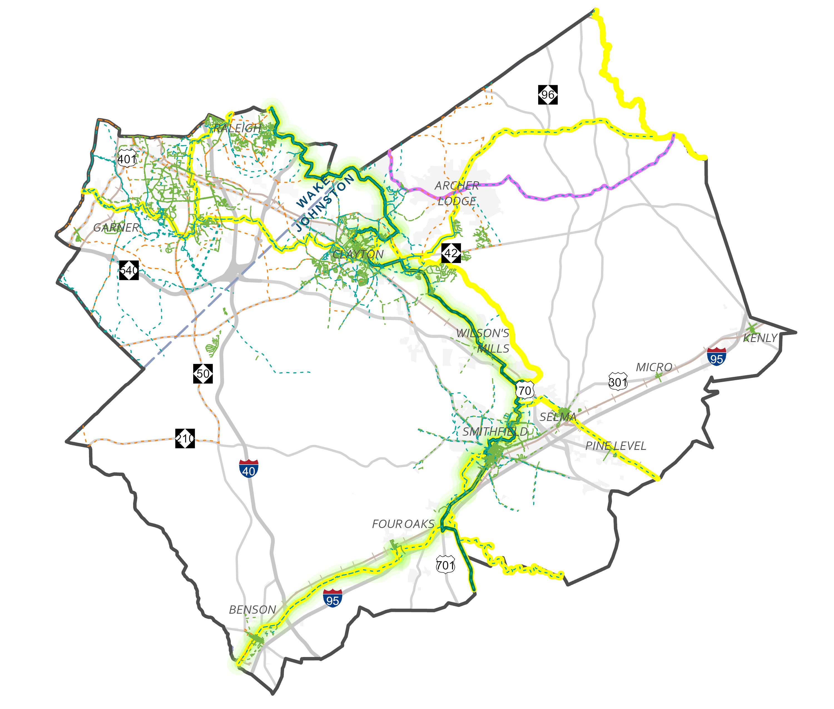
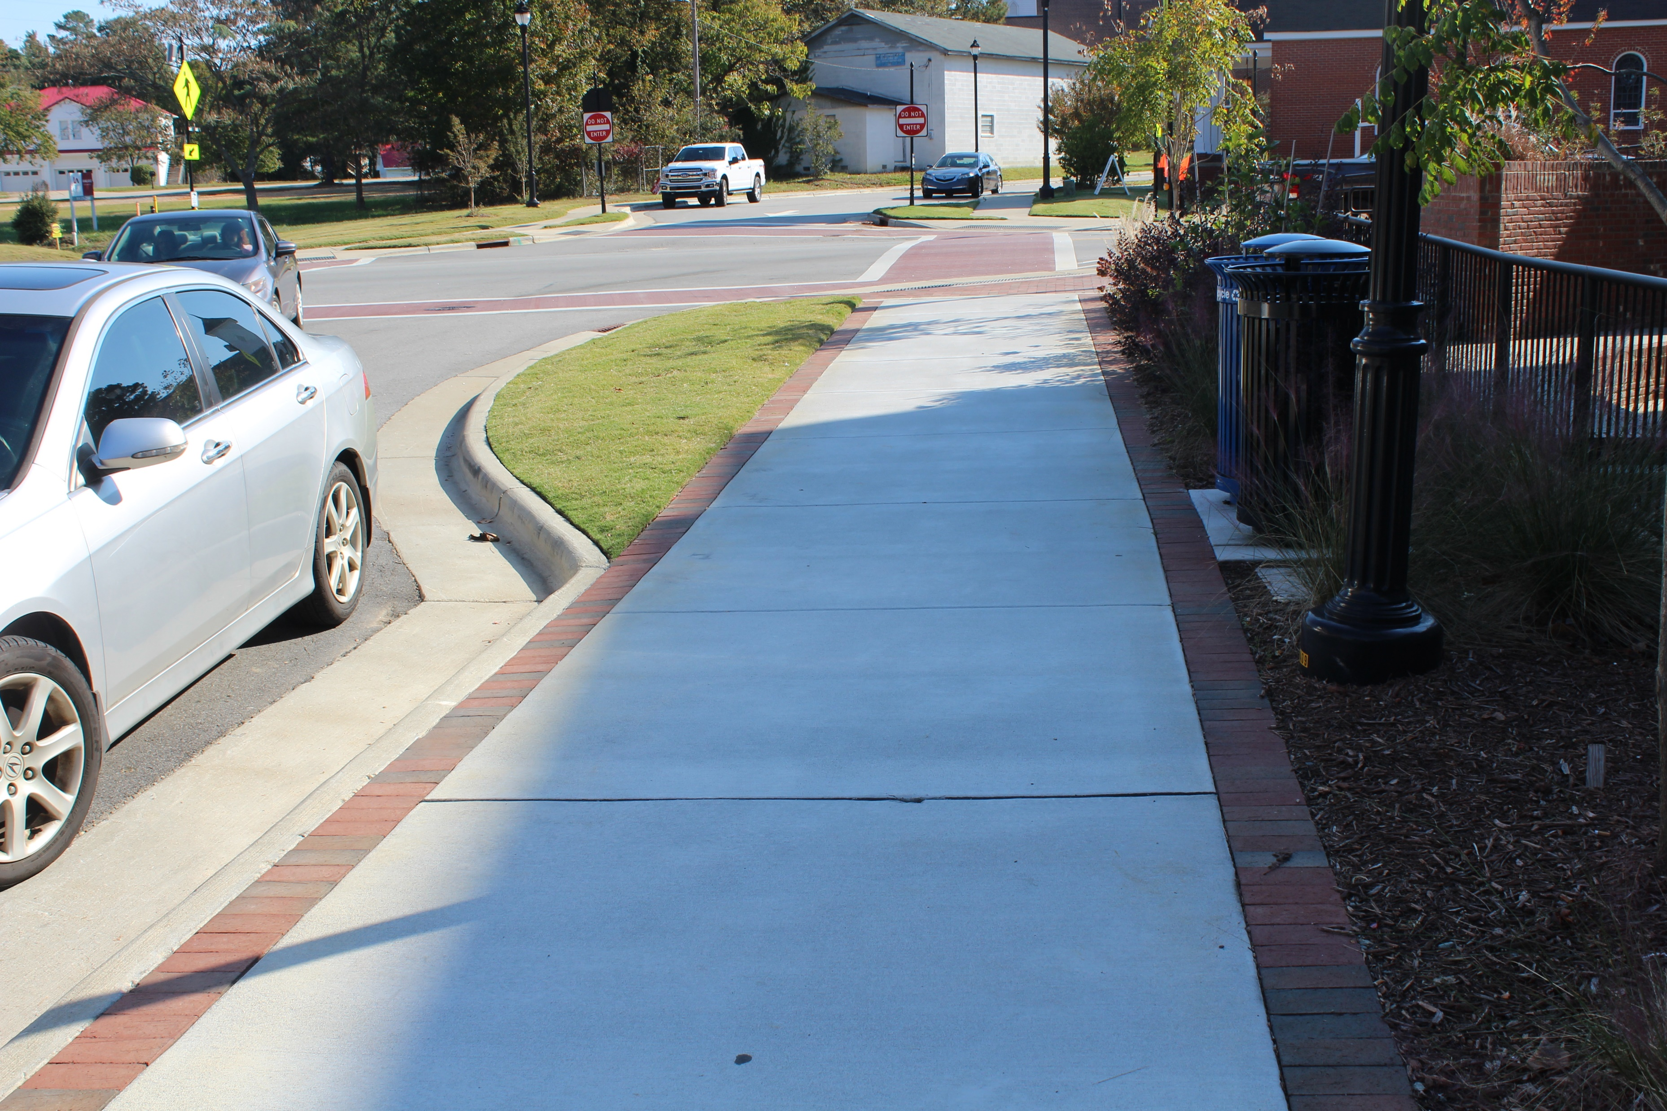
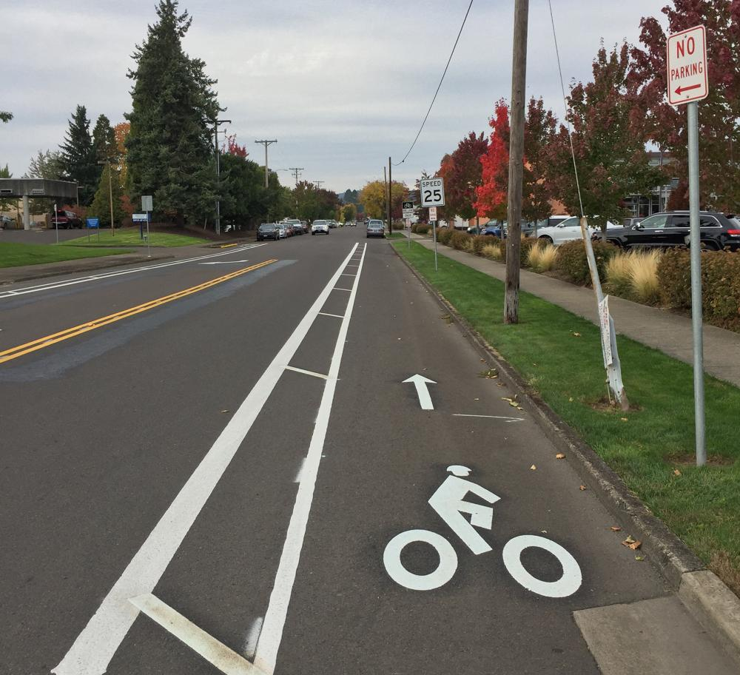
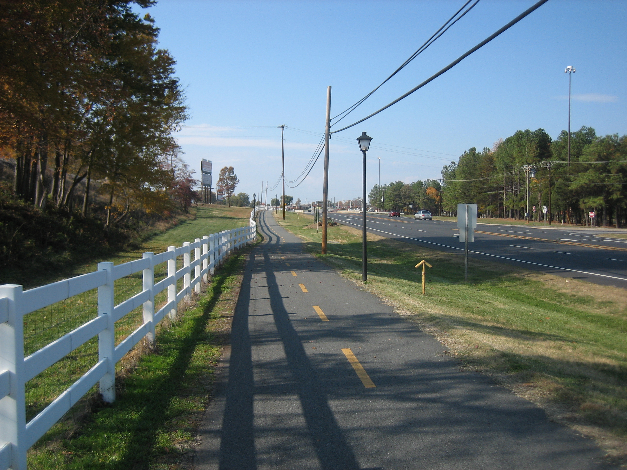
Recommendations | Bicycle and Pedestrian
Proposed Pedestrian Facility (Sidewalk)
Proposed Bicycle Facility (Bike Lane)
Proposed Multiuse Path (Greenway)
Notes:
Our bicycle and pedestrian recommendations include adding sidewalks, adding on-street bike lanes, and adding proposed “multiuse paths,” sometimes called greenways, for both pedestrians and bicyclists.

Slide 18
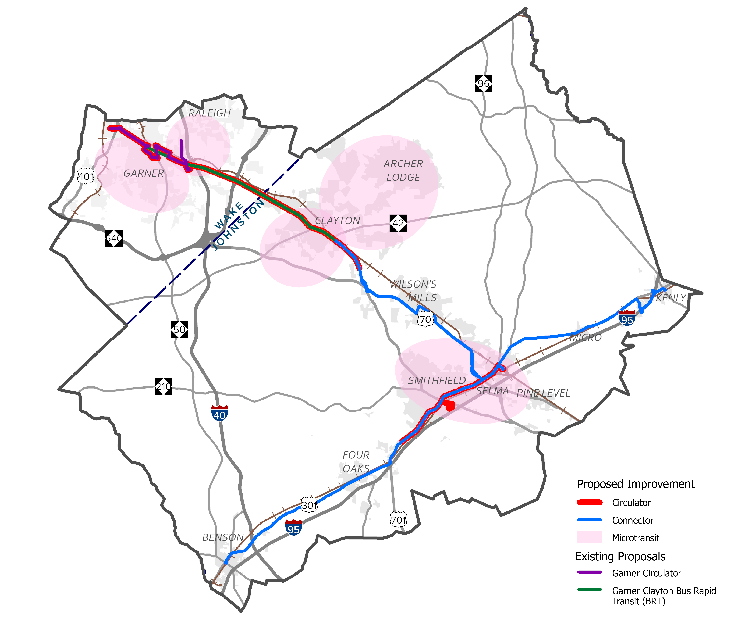
Recommendations | Transit
Circulator
Frequent connections between key destinations and transfer points
Regional Connector
Extended connections between communities
Microtransit
On-demand, curb-to-curb service
Notes:
Our transit recommendations include a combination of frequent circulators, longer-distance regional connectors, and microtransit, which is an on-demand, curb-to-curb service.
There are three types of transit recommendations included in this plan:
Circulators are frequent, fixed-route bus service connecting key destinations and transfer points within communities
Regional Connectors are extended fixed-route bus connections between communities. These usually run less frequently than circulators since they travel a longer distance.
Microtransit is an on-demand, curb-to-curb service, connecting residents to destinations throughout their community, as well as circulators and regional connectors. Microtransit usually runs with smaller shuttles that pick people up in designated locations once notified via an app on your phone.
The proposed transit recommendations include:
A circulator between Selma and Smithfield
A circulator between Clayton and Garner
A regional connector between Selma and Raleigh
A regional connector between Benson and Selma
A regional connector between Kenly and Selma
And microtransit zones in Smithfield, Clayton, NC 42 corridor between Clayton and I-40, Garner, and surrounding areas of higher need.

Slide 19
Recommendations | Transit Supporting Policies
Successful transit services require adequate bicycle and pedestrian access, as well as passenger amenities at stops
Proposed circulator and regional connectors stops should have sidewalks and crosswalks
Stops should have shelters, benches, lighting, trash, and passenger information, and comply with ADA guidance
Bus stops readily accessible for users of all ages and abilities
All transit trips start and end on two feet or two wheels and the transportation environment should take the entire trip into account
Notes:
The transit recommendations are paired with the following supporting policies.

Slide 20
Recommendations | Transit Supporting Policies
Transit is most successful in areas with supportive density- aka a high enough density of homes and jobs to support ridership
Areas planned for mixed use centers or other dense development are likely to be able to support transit in the future and are long-term transit opportunities
As planned developments are built out, consider reexamining routings to serve these areas

Slide 21
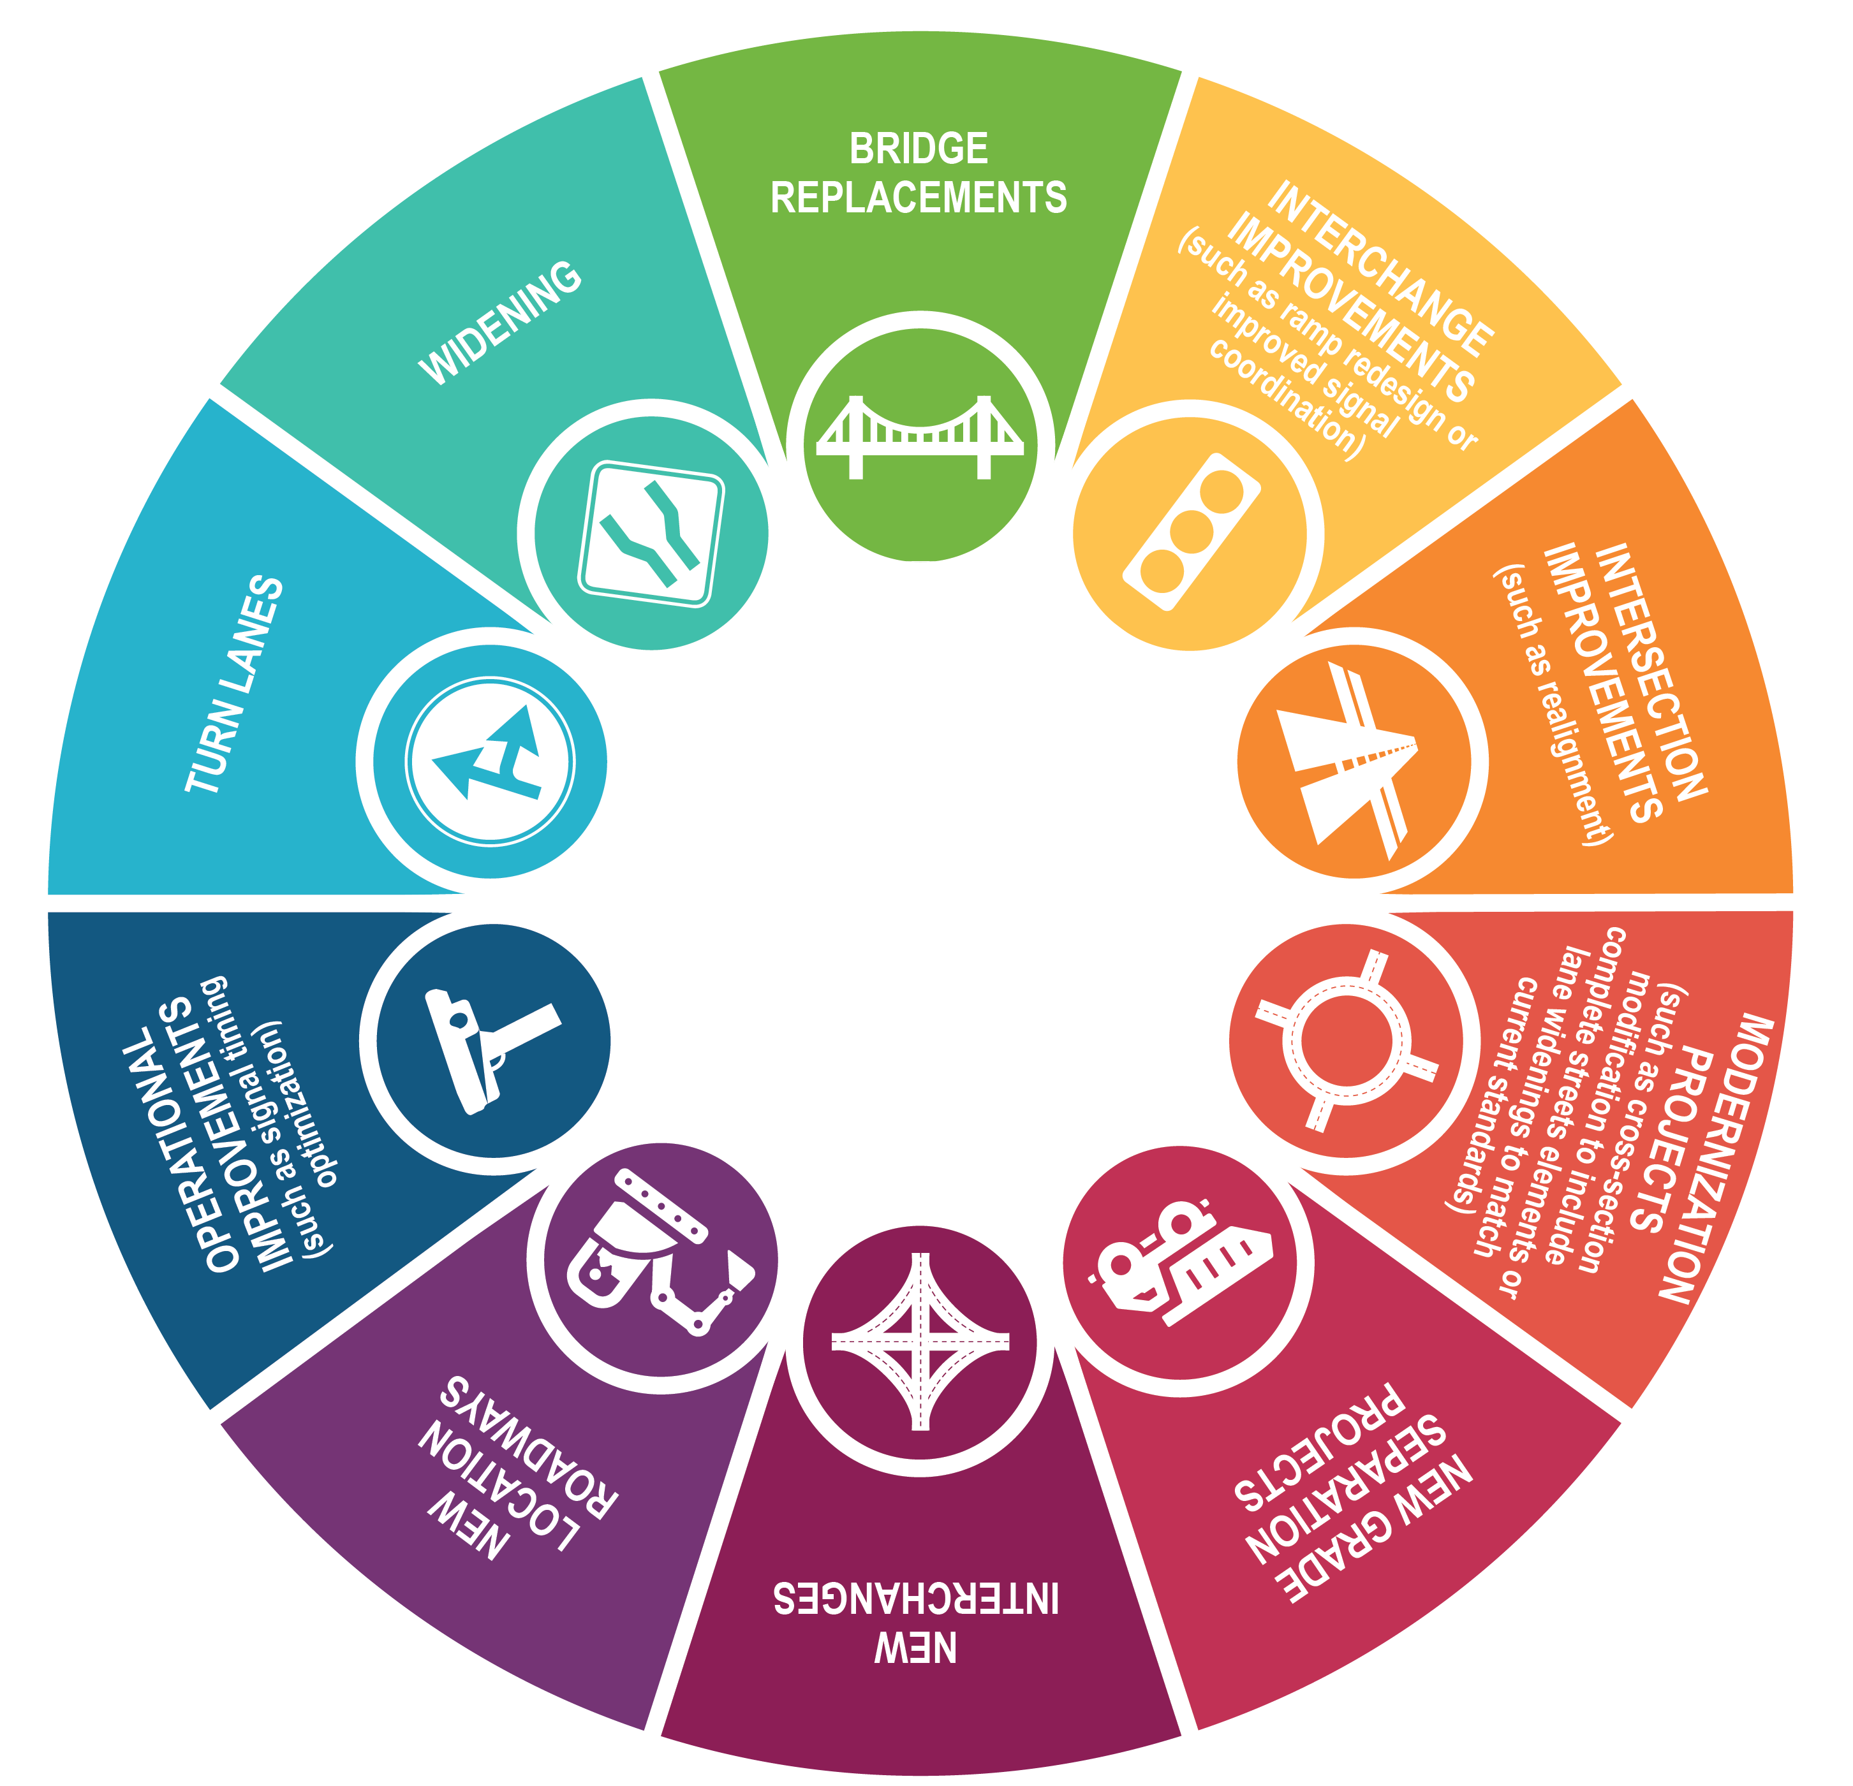
Recommendations | Roadway
Notes:
Roadway and intersection improvements come in many forms as shown here.
Bridge replacements are recommended to ensure bridges remain in good working condition
Interchange improvements can include redesigning the ramps or improving signal coordination
Intersection improvements can cover a variety of things including signal improvements or other stop controls, or realignments to improve safety and improve traffic throughput
Modernization projects usually recommend upgrading roadways to current design standards
New grade separations are the building of a new bridge to allow one road to run above and across another one
New interchanges are usually used to access major roadways or interstates
New location roadways are the construction of a new road to provide drivers with increased options and help distribute vehicular traffic
Operational improvements include optimizing signal timing
Turn lanes are the addition of a center turn lane along an entire corridor or for a smaller area such as an intersection
Widening is the final improvement type. It is the addition of at least one lane of travel in each direction, usually to address congestion or safety concerns

Slide 22
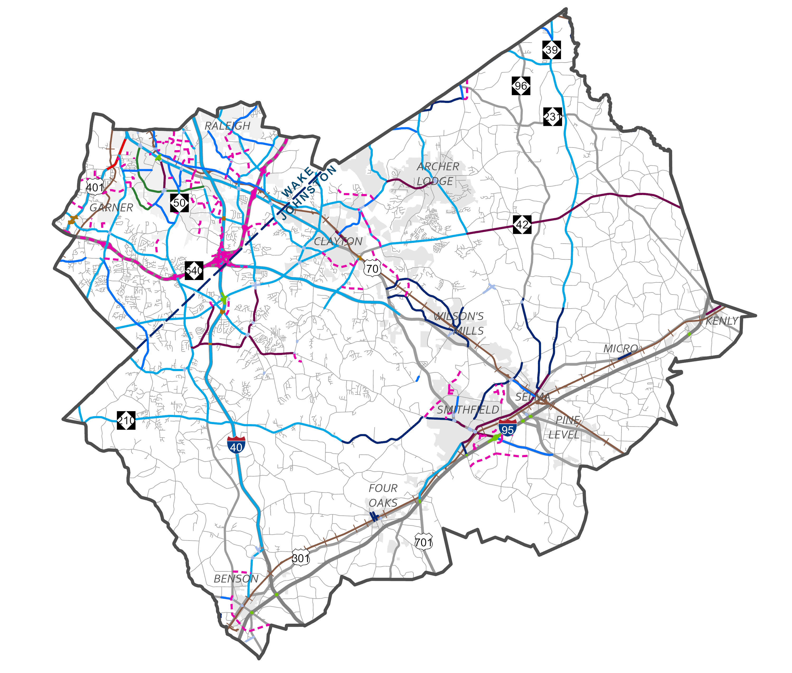
Recommendations | Roadway
Notes:
Our draft roadway and intersection recommendations include a range of improvements to traffic flow, access, connectivity, and safety. This map shows our roadway recommendations.

Slide 23
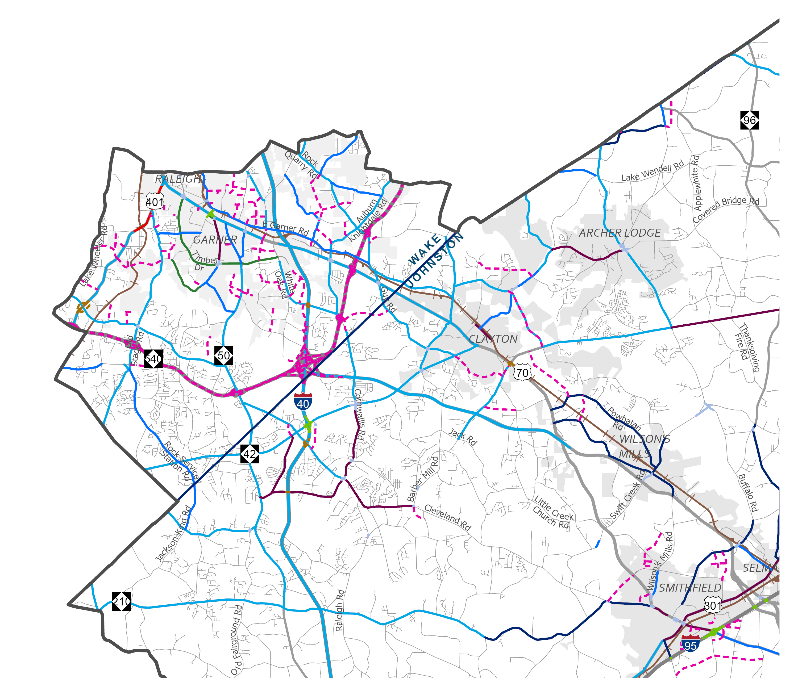
Roadway | Wake County

Slide 24
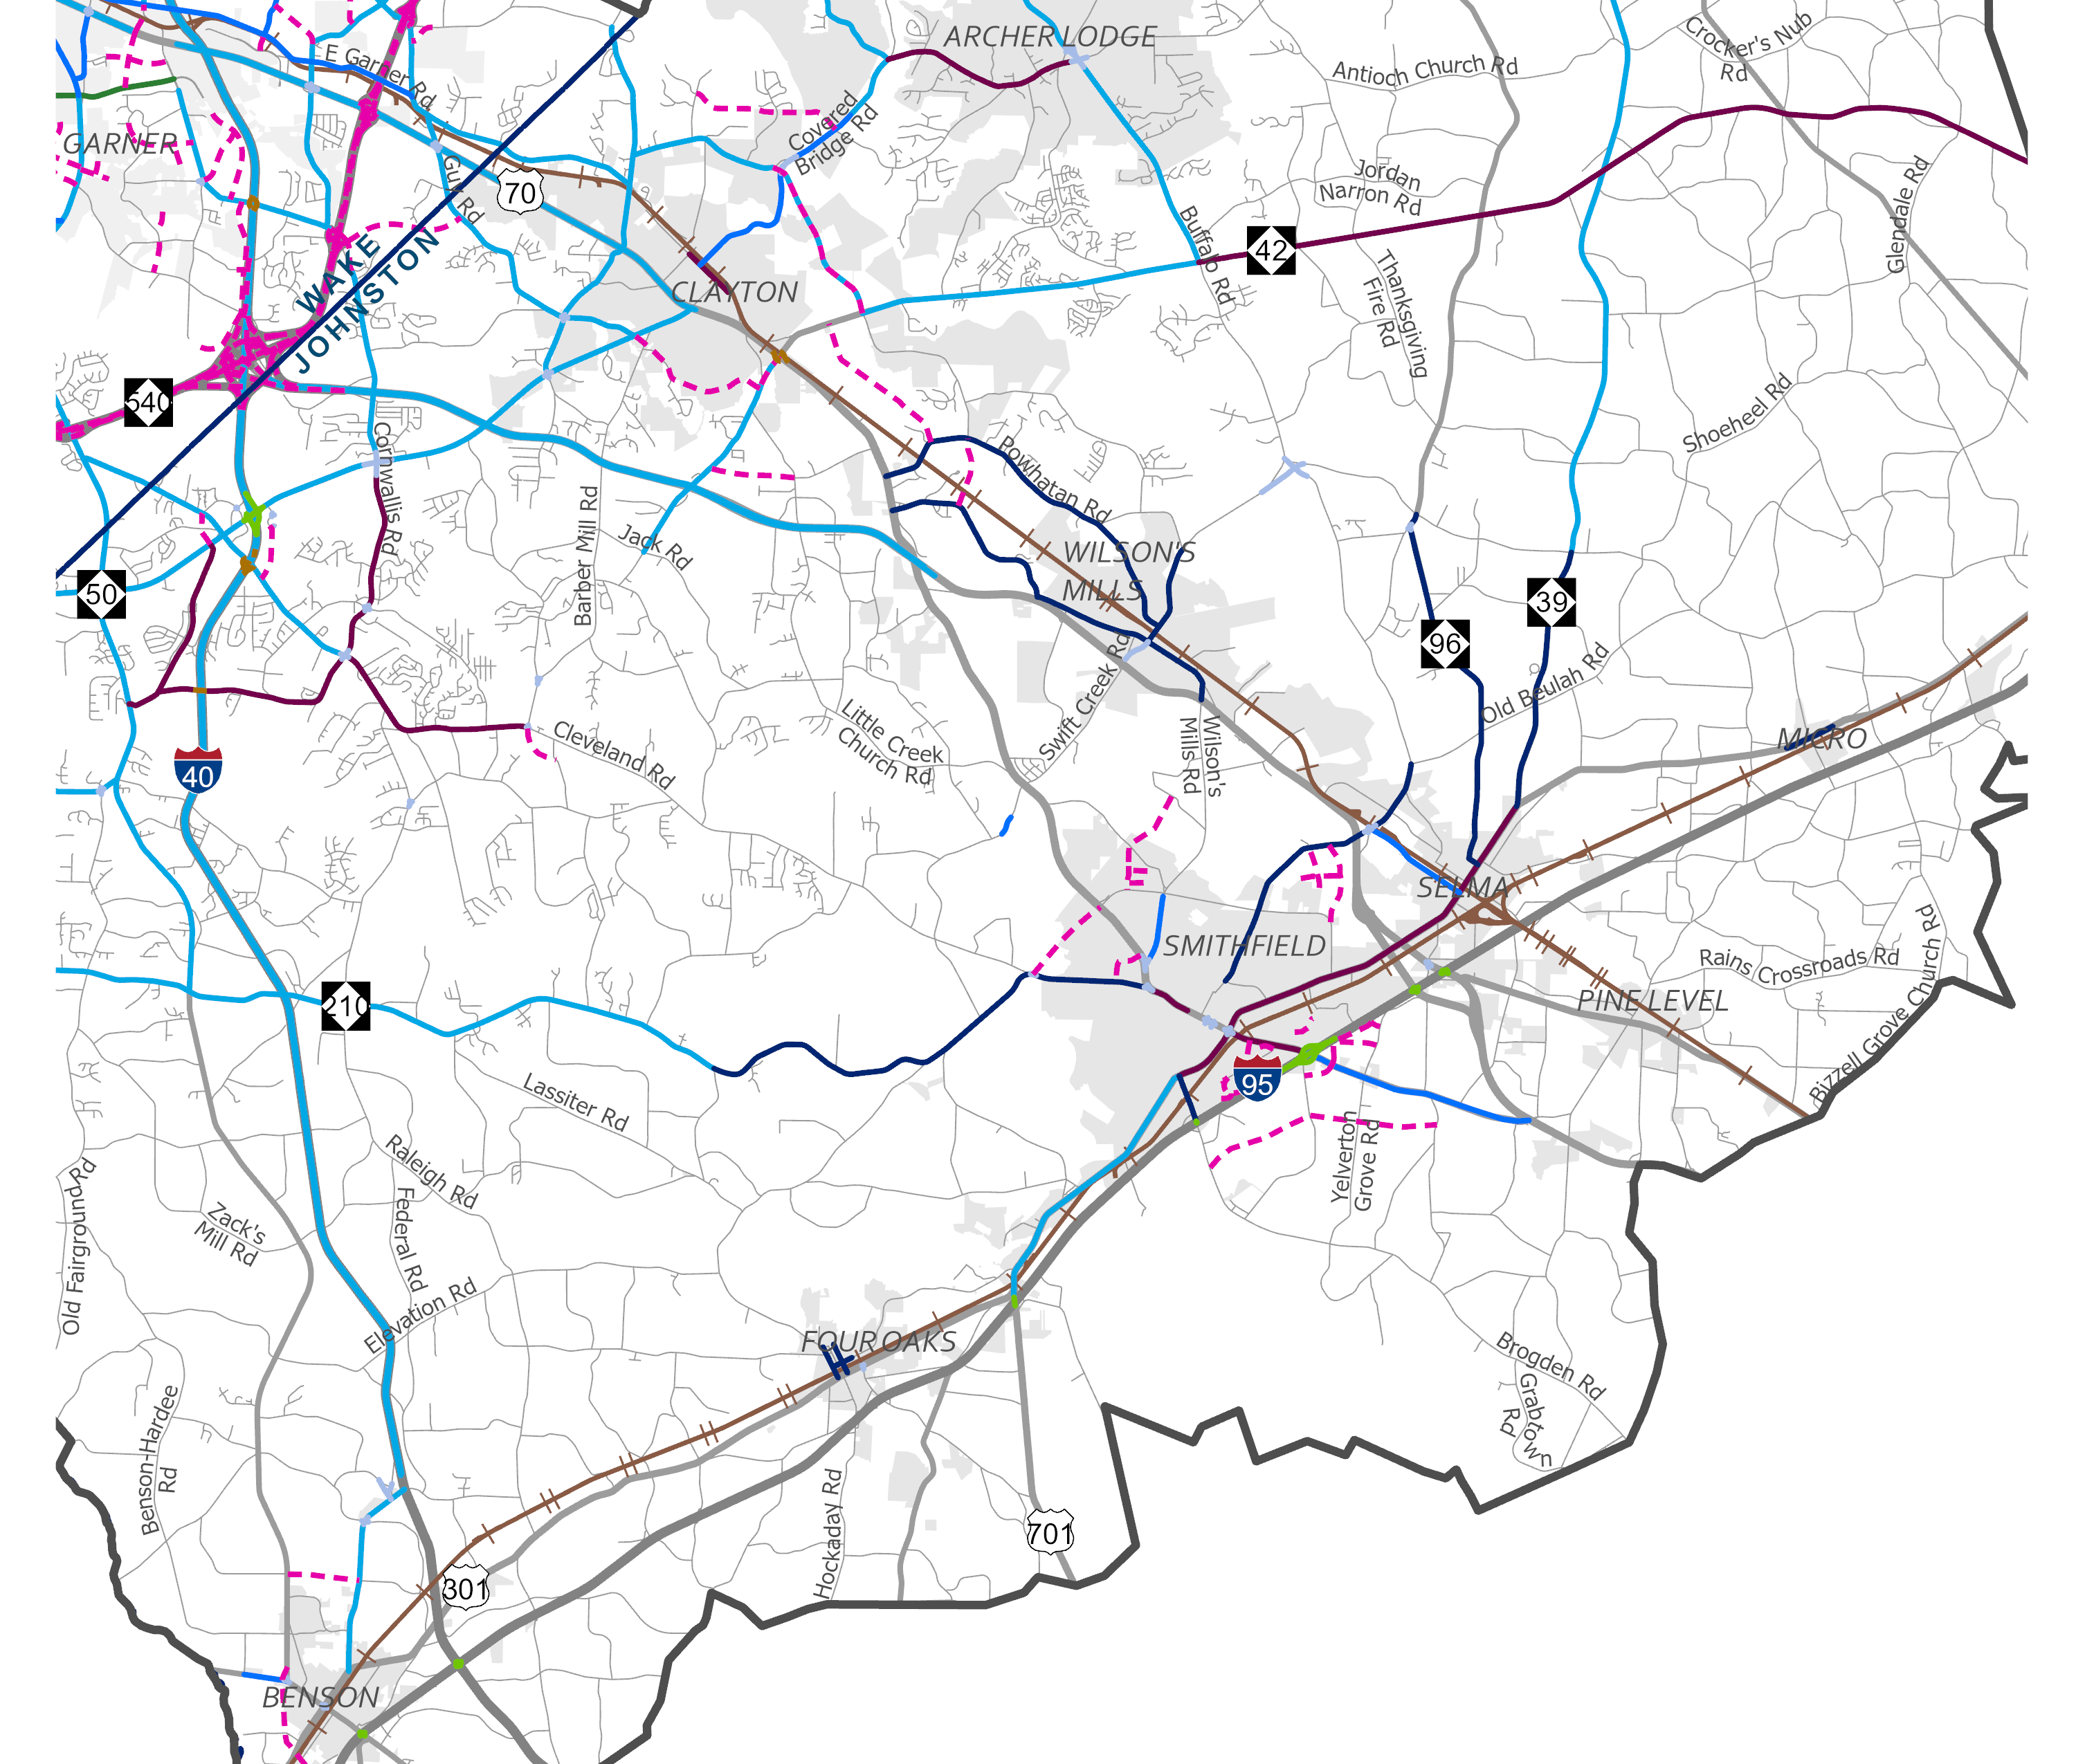
Roadway | Johnston County

Slide 25
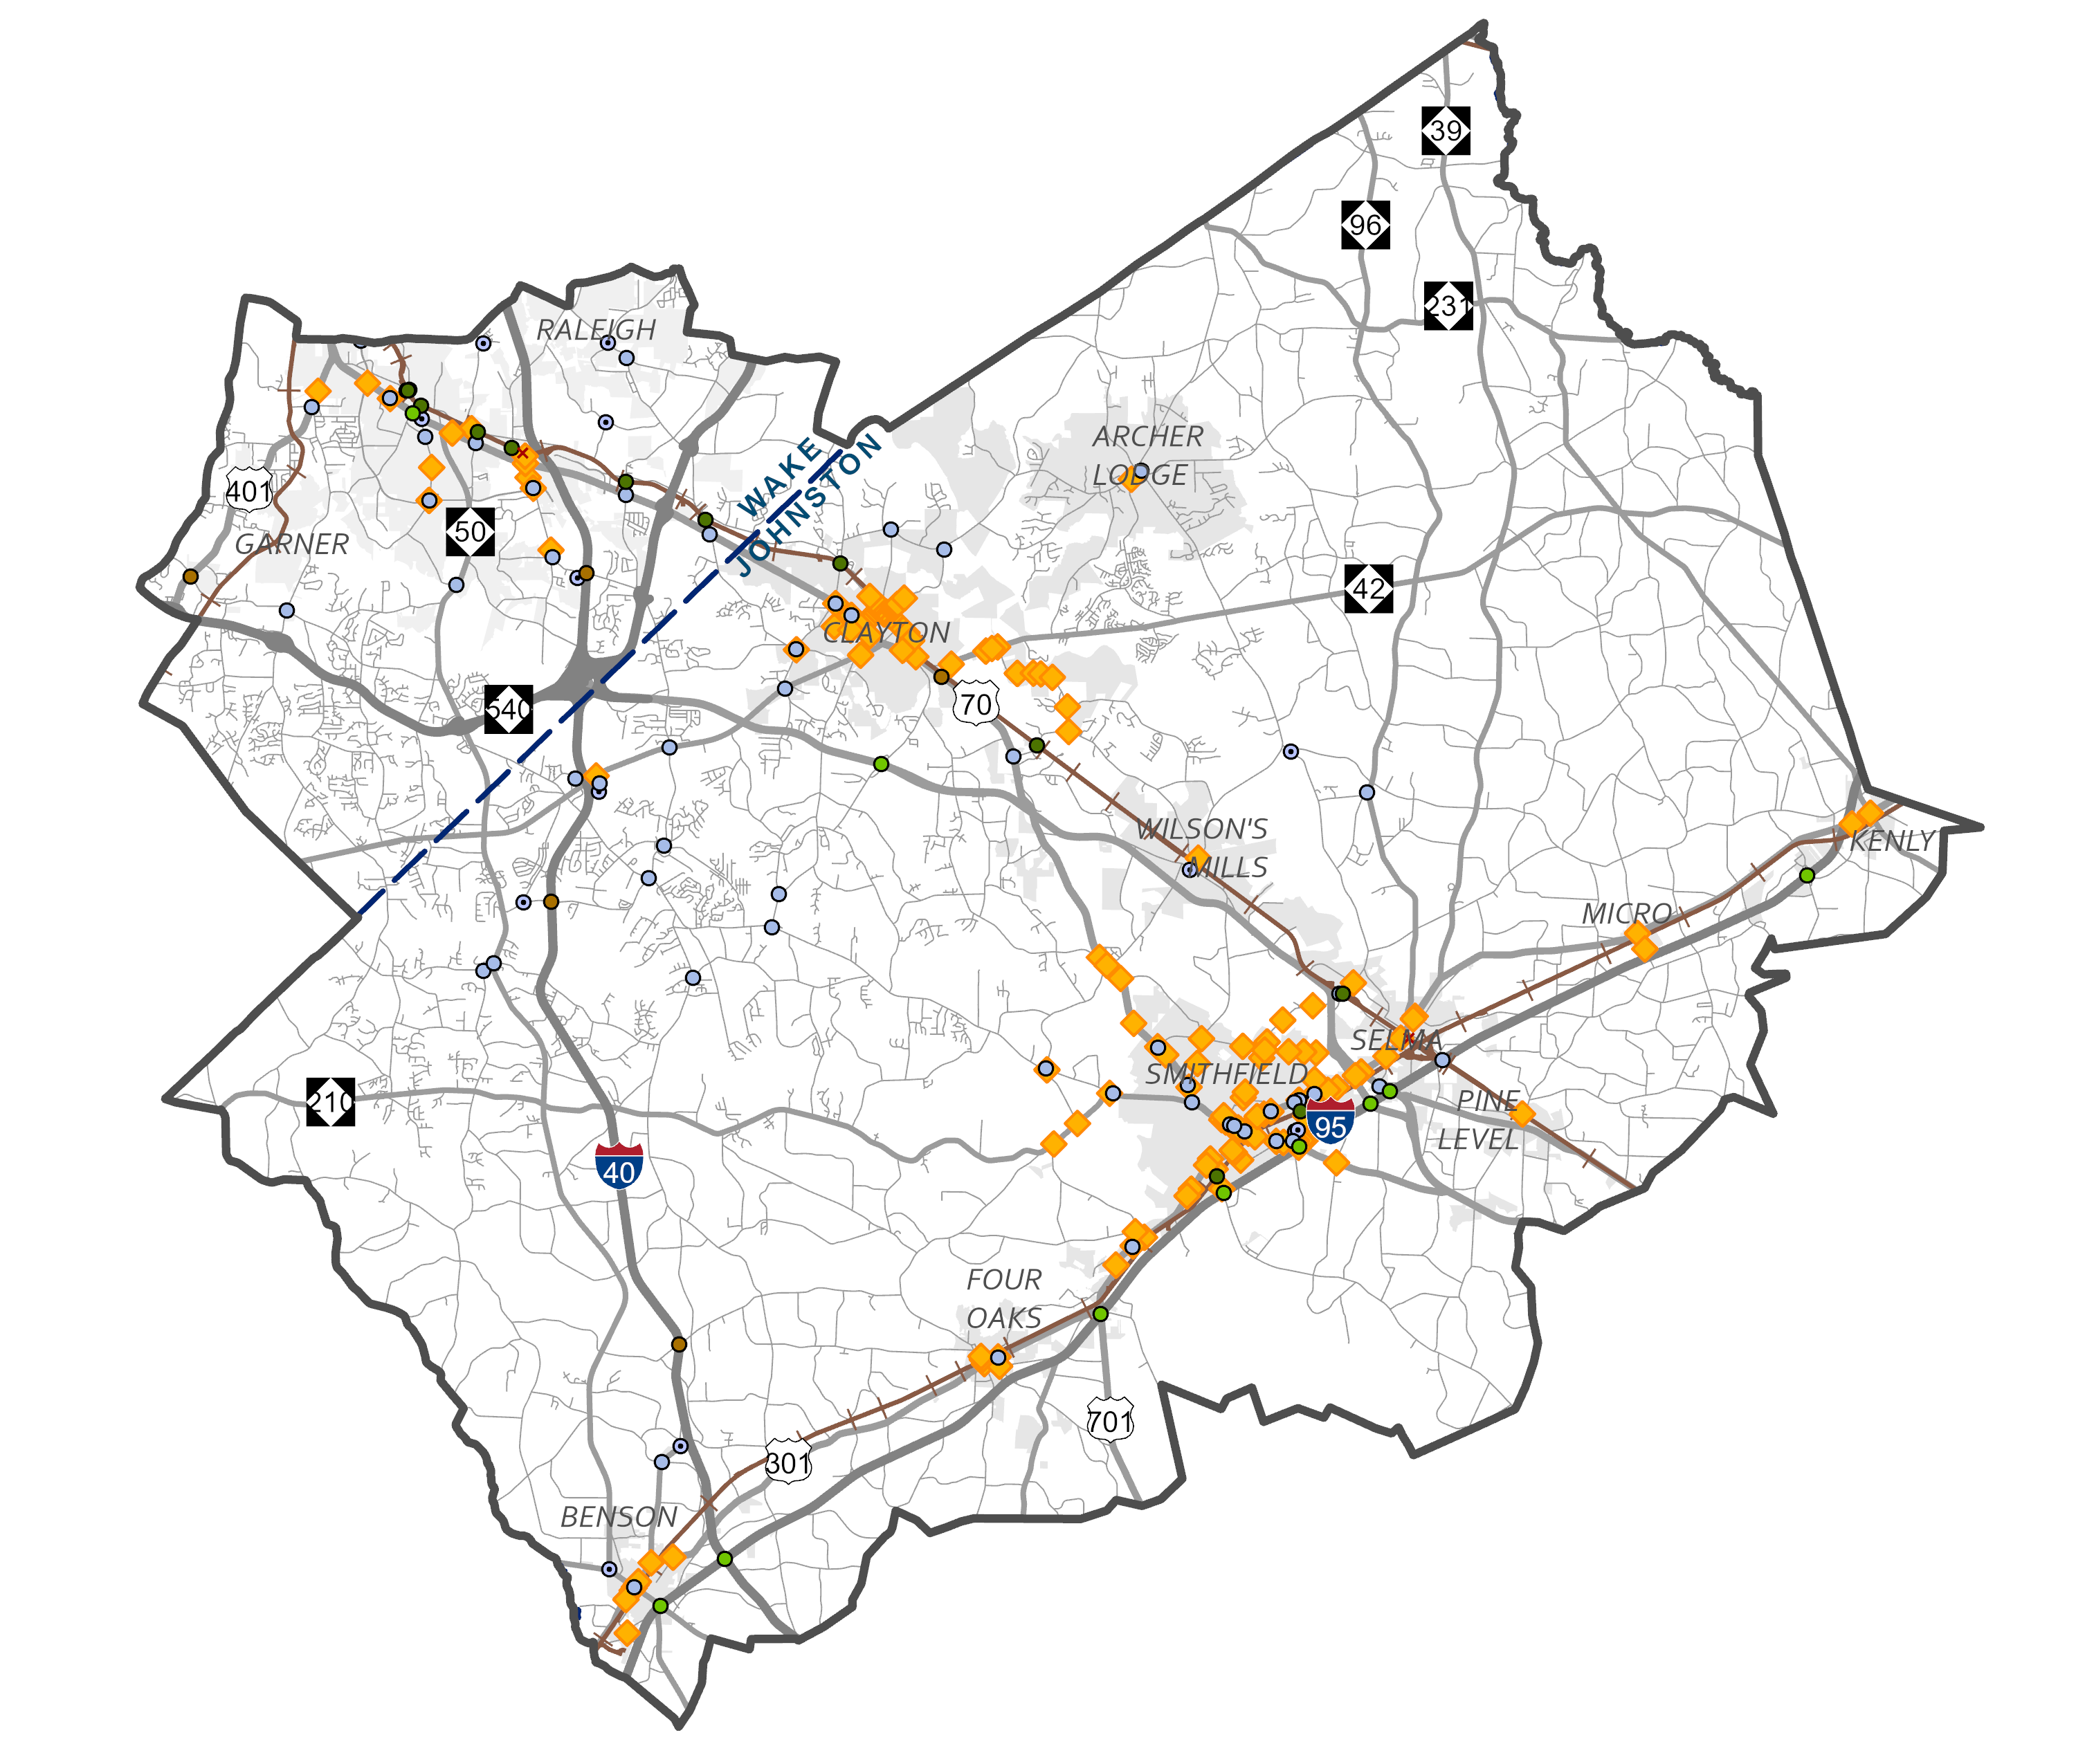
Recommendations | Intersection
Notes:
And this map shows our intersection recommendations. You can view all these recommendations in more detail on the project’s website.

Slide 26
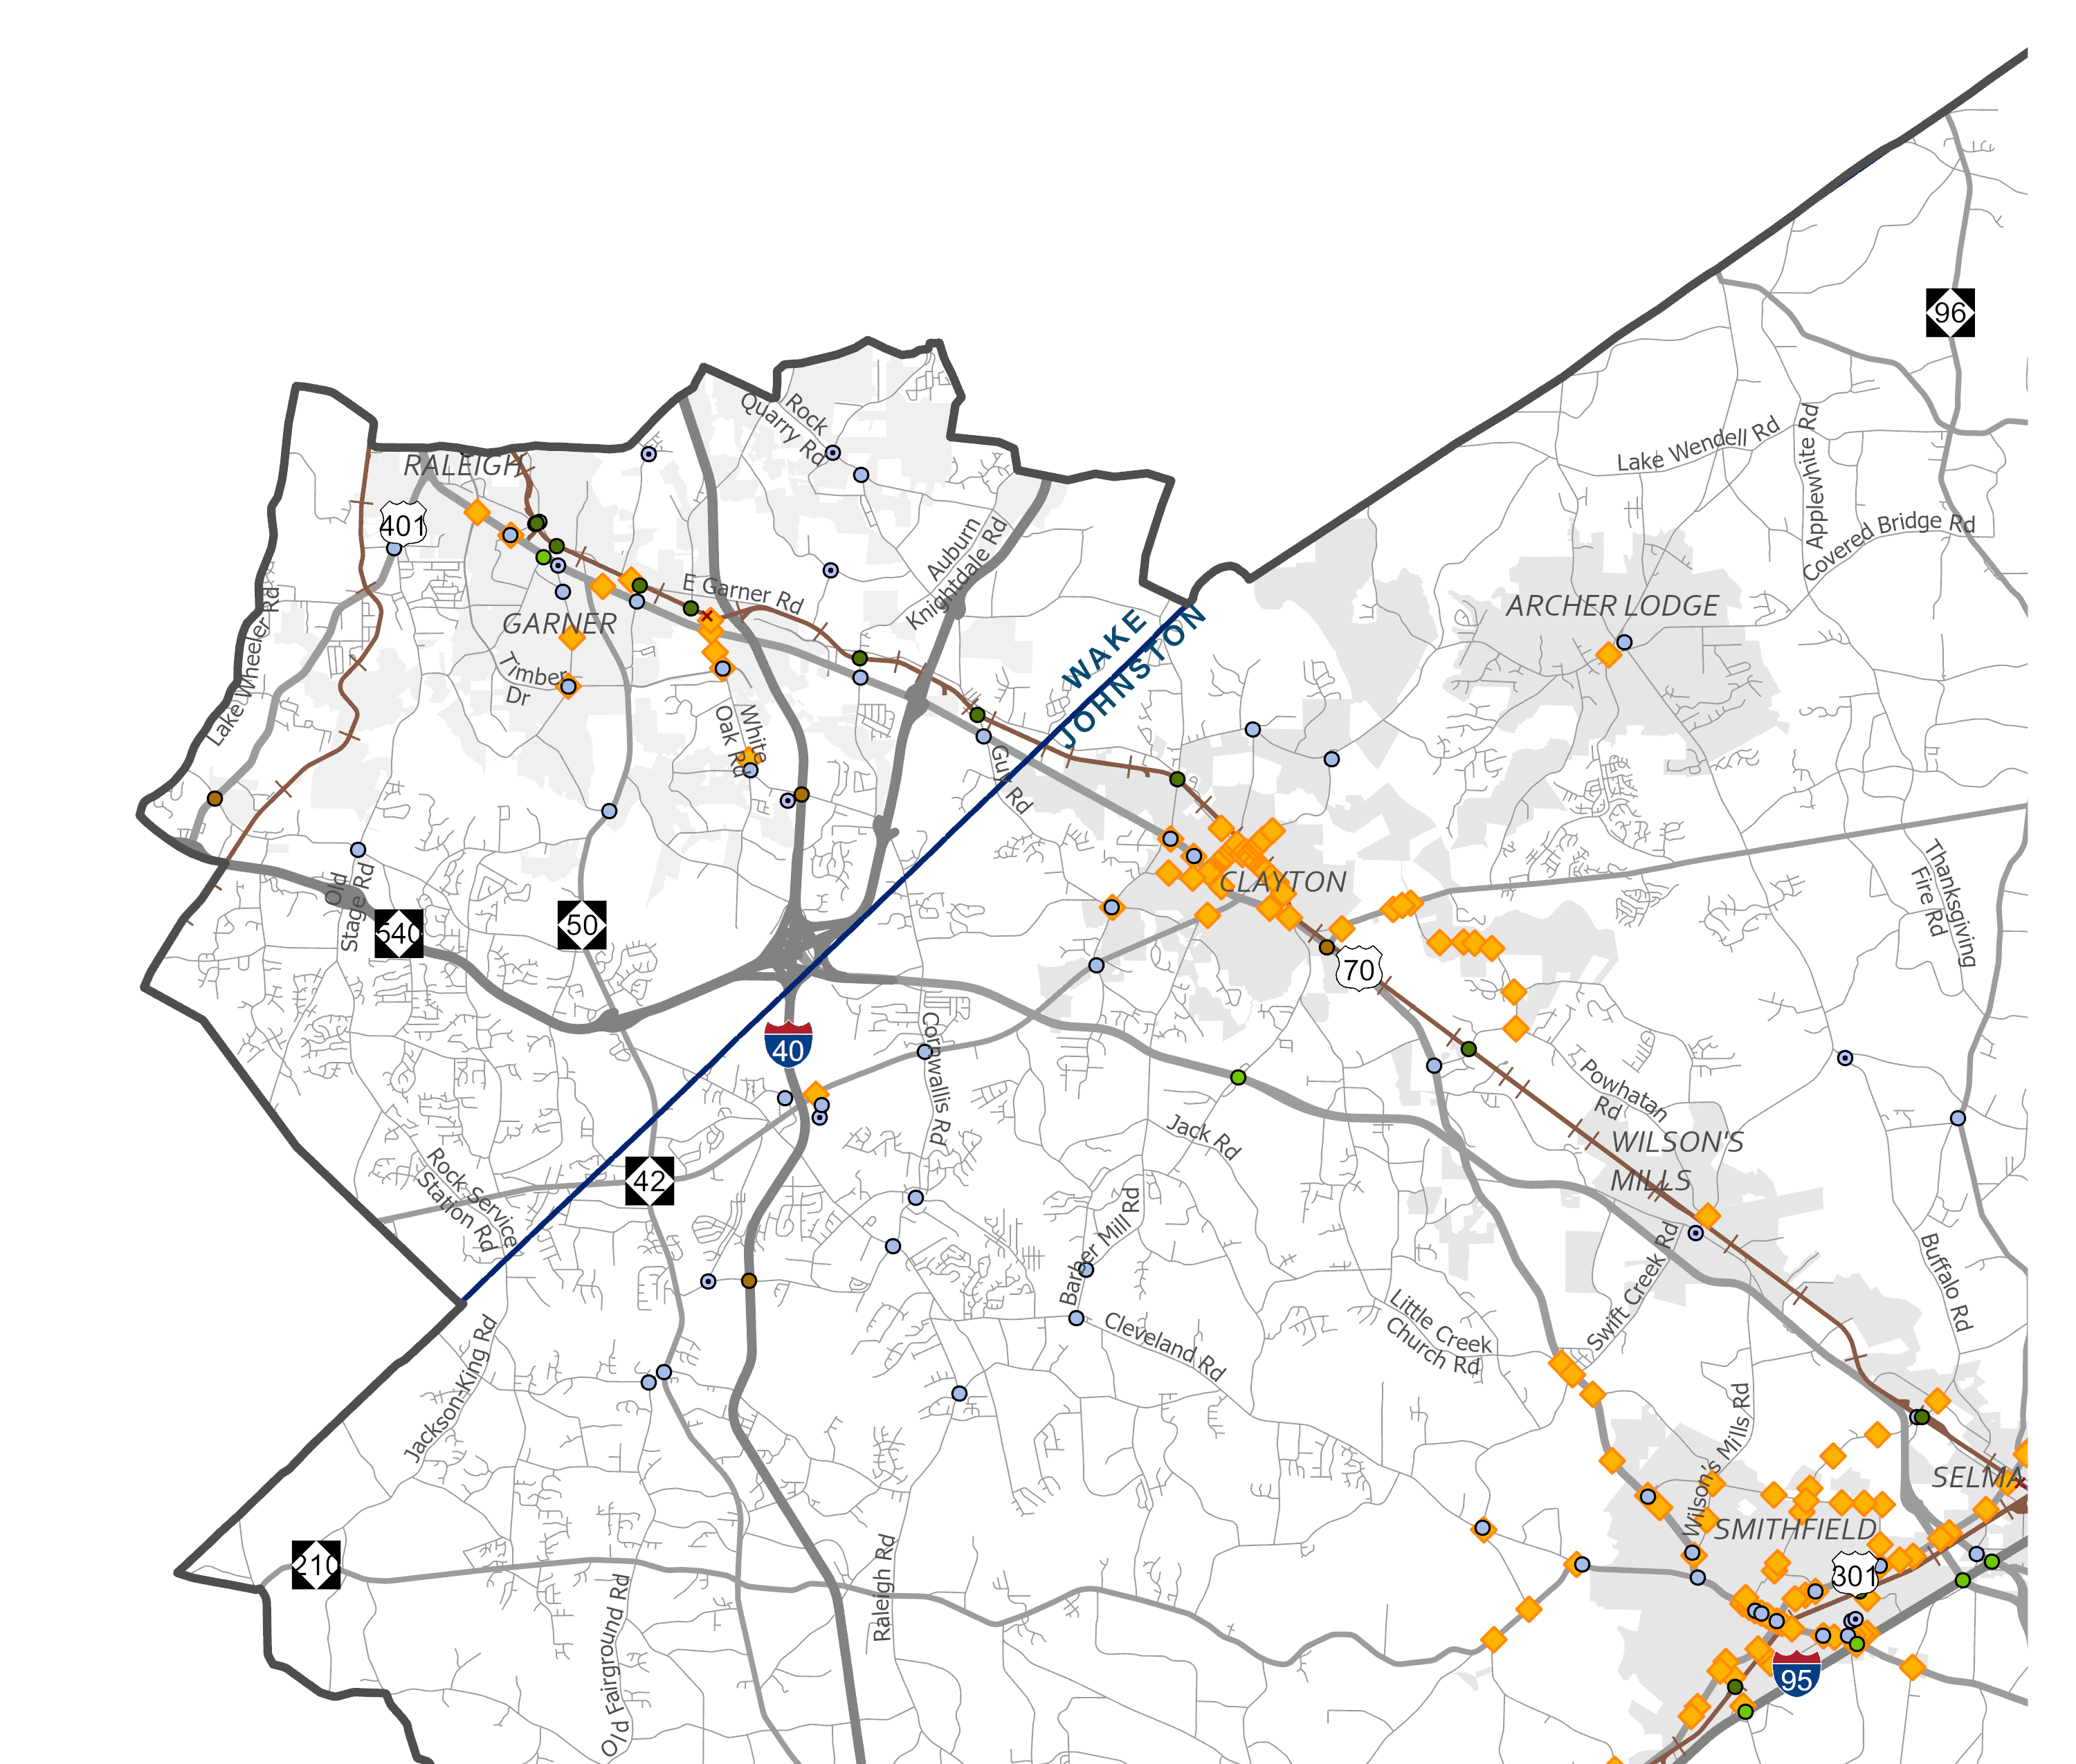
Intersection | Wake County

Slide 27
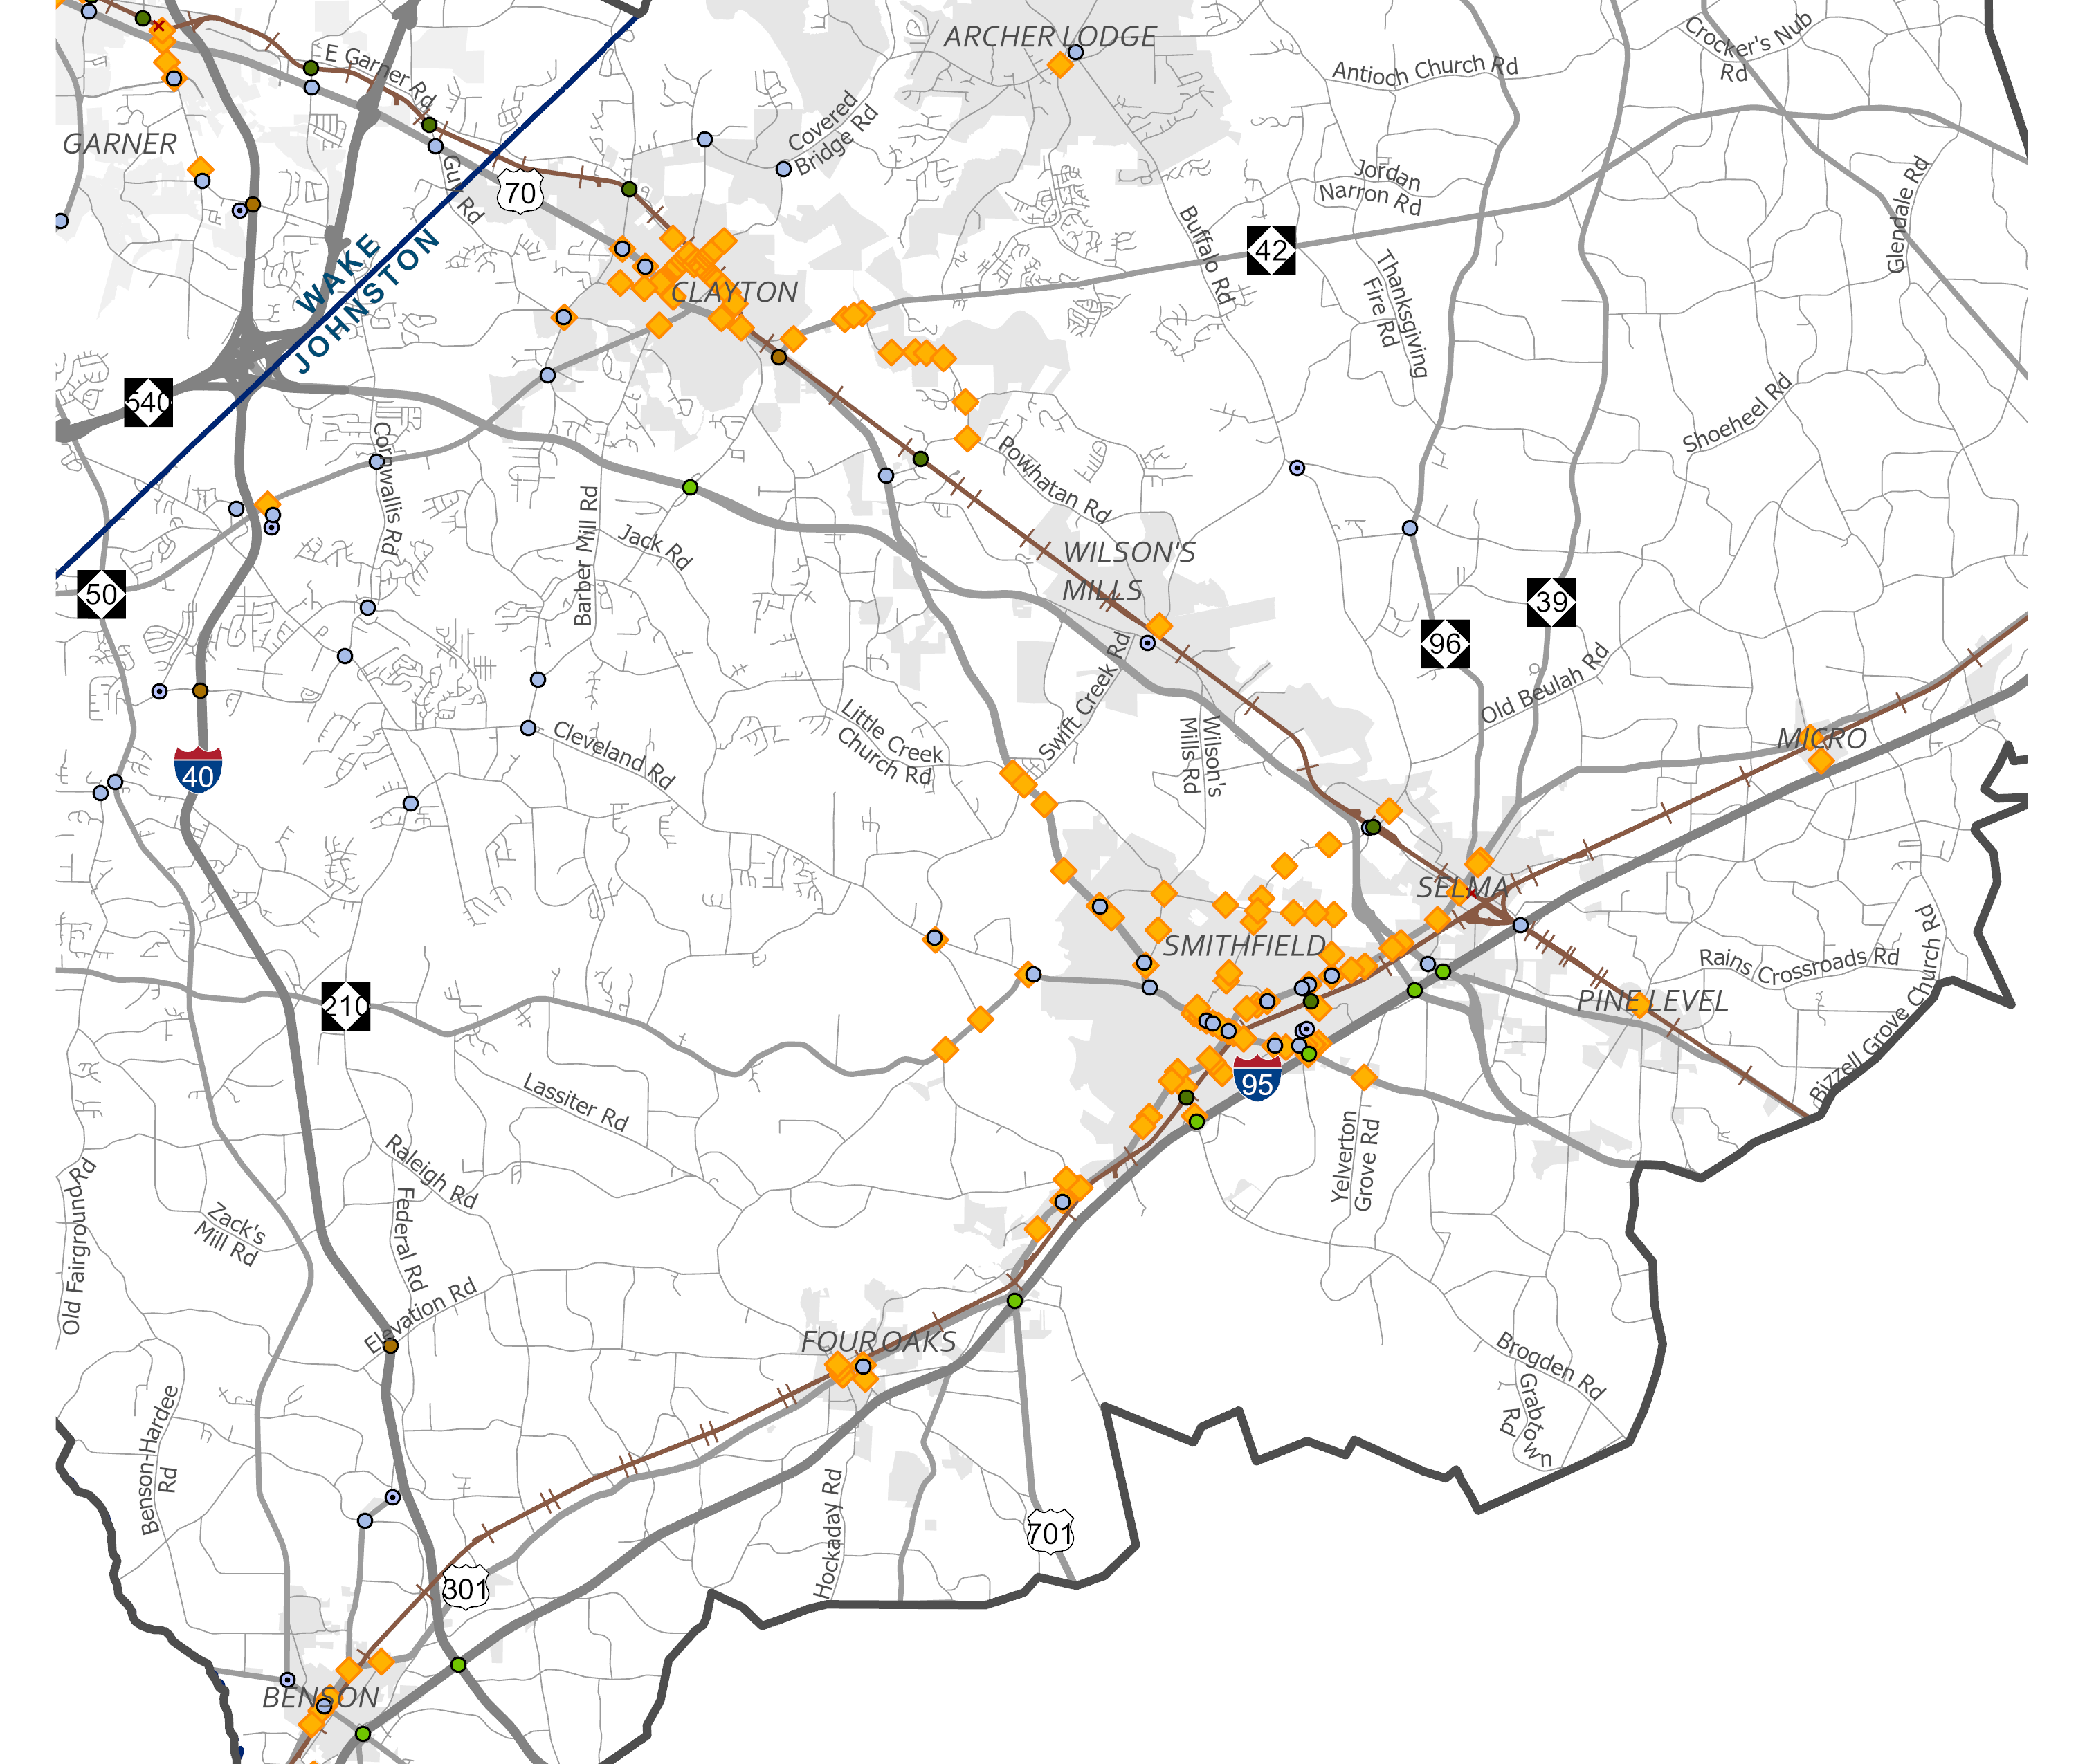
Intersection | Johnston County

Slide 28
Project Prioritization
Notes:
The recommendations in the Southeast Area Study Update are part of a long-term vision that includes projects that may be constructed within the next 10 years and projects that likely would not be constructed until 2055 or later. While this collective vision attempts to address the many wants and needs across the Southeast Area, the reality is that there is limited funding available each year to make these recommendations a reality, so we need to prioritize the projects.

Slide 29
Prioritization | Criteria
Connect people and places | Access to Opportunity – Travel time savings for people traveling to work or education destinations with commute longer than 30 minutes
Promote and expand multimodal and affordable transit choices | Access to Transit – Prioritize project that provide travel time savings along transit routes Bike infrastructure – Prioritize projects that include bike lanes based on need identified by current Bike Score Pedestrian infrastructure – Prioritize projects that include sidewalks, crosswalks, etc. lanes based on need identified by current Walk Score
Manage congestion and system reliability | Congestion – Prioritize projects which will have the most impact on improving peak period travel times Reliability – Prioritize projects which will have the most impact on improving travel time reliability multiplied by VMT
Stimulate inclusive economic vitality and opportunity | Truck Congestion – Prioritize projects which will have the most impact on improving truck travel times Truck Reliability – Prioritize projects which will have the most impact on improving truck travel time reliability multiplied by truck VMT Density – Prioritize projects that will improve walking, biking, transit in locations with a close ratio of jobs to residents within project’s census tract Relative benefit cost ratio – Prioritize similar project by total benefits compared to cost
Notes:
Prioritization criteria is used to measure and score all the projects. The following criteria were created to align with the CAMPO Strategic Plan.

Slide 30
Prioritization | Criteria
Ensure equity and participation | Benefits for CoC neighbors and users – Prioritize projects with benefits for nearby Communities of Concern and people from CoC areas who may use the facility.
Improve infrastructure condition and resilience | Functionally obsolete bridges – Prioritize bridge projects that improve more functionally obsolete bridge deck area
Protect the human and natural environment and minimize climate change | Change in greenhouse gas (GHG) emissions – Prioritize projects with greater reductions in GHG emissions
Promote safety, health and well-being | Change in excess expected fatal and serious injury crashes – Prioritize projects projected to have the greatest impact on reducing fatal and serious injury crashes

Slide 31
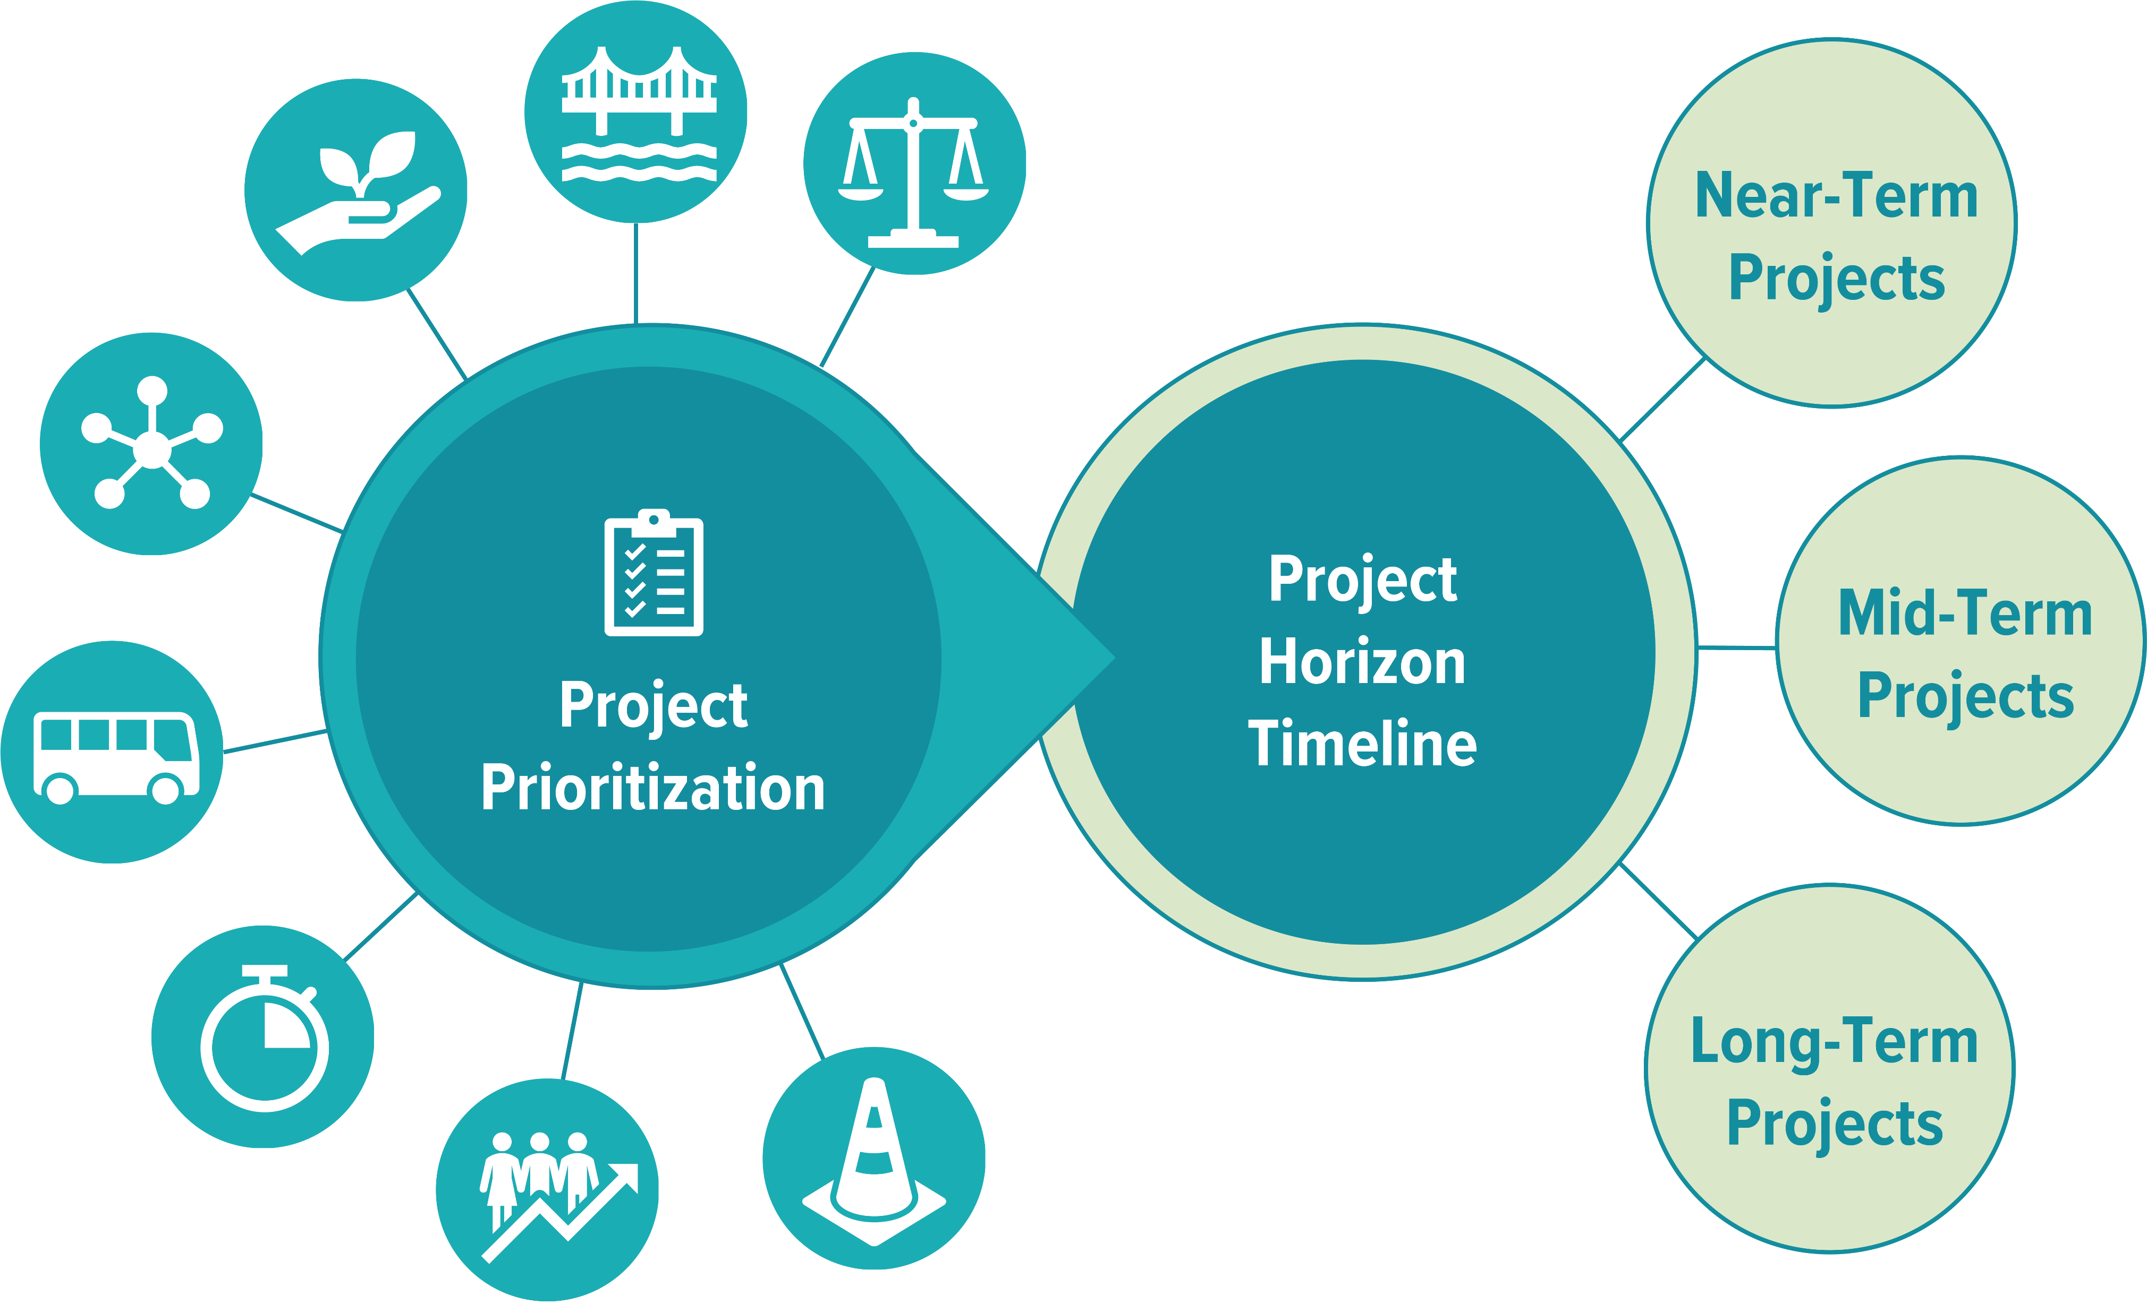
Prioritization | Process
Notes:
Once we understand the public’s priorities, weights are applied to the criteria that then inform and sort the projects into horizon time bands.

Slide 32
Public Engagement

Slide 33
Phase II Engagement
Advertising
Social Media Posts
Email Blasts
Stakeholder Dissemination
Educating
Project Website
Overview Video
Receiving (Feedback)
Public Symposium
Online Survey
Pop-Up Events
Purpose: Educate the public on the preferred scenario and gather feedback on draft modal recommendations and project priorities

Slide 34
Unhide slide if before June 22
Public Symposium | Join Us!
Date
Time
Location
Thursday
June 22nd, 2023
Public Symposium
5-7pm
Garner Town Hall
900 7th Ave, Garner
Drop by anytime!
Notes:
You can also join us for a Public Symposium on Thursday, June 22nd at Garner’s Town Hall. You’re welcome to stop by at anytime between 5 and 7 PM to learn more about the project, talk with the project team, and provide your comments and feedback.

Slide 35
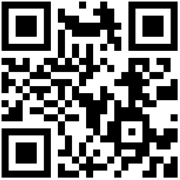
Online Survey | Take the Survey!
seareastudyupdate.com
Live now!
Let us know what you think about the draft recommendations!
Scan here!
Notes:
On the website you’ll find the online survey where you can review the recommendations more closely and share your thoughts on project priorities. Please take the survey and encourage your friends and neighbors to do so as well.

Slide 36
Project Website | Visit Often
seareastudyupdate.com
Scan here!
Notes:
The Southeast Area Study’s project website is the best place to visit for project information, the latest updates, and engagement information.

Slide 37
Ongoing & Upcoming Steps
Phase II Engagement
SOT and Public release of draft preferred scenario and draft modal recommendations
Prioritization and Cost Estimation
Documentation and Reporting
TCC and TAC Endorsement

Slide 38
Thank You!
June-July 2023
seareastudyupdate.com

